Slide 1
Batch correction methods for scRNAseq
Etienne Becht
Carte d’Identité des Tumeurs program of the Ligue Nationale Contre le Cancer
26/01/2021
scRNAseq OPEN group
co-organized by
Carte d’Identité des Tumeursm ESPCI and Institut Curie

Slide 2
Rationale
Definition: correct for unwanted (technical) variability to highlight wanted (biological) variability
Selection of algorithms
LIGER, Harmony and Seurat v3
Brief overview of each method
Simulations
splatter scRNAseq simulation framework
Benchmark parameters in a controlled manner to build intuition
Real datasets (collated by Lütge et al, bioRxiv, 2020)
Practical utility
Comparison with results from simulations
Conclusions

Slide 3
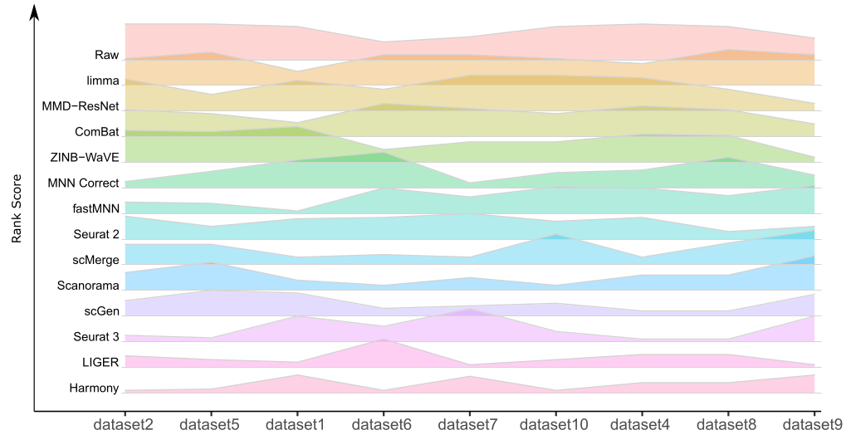
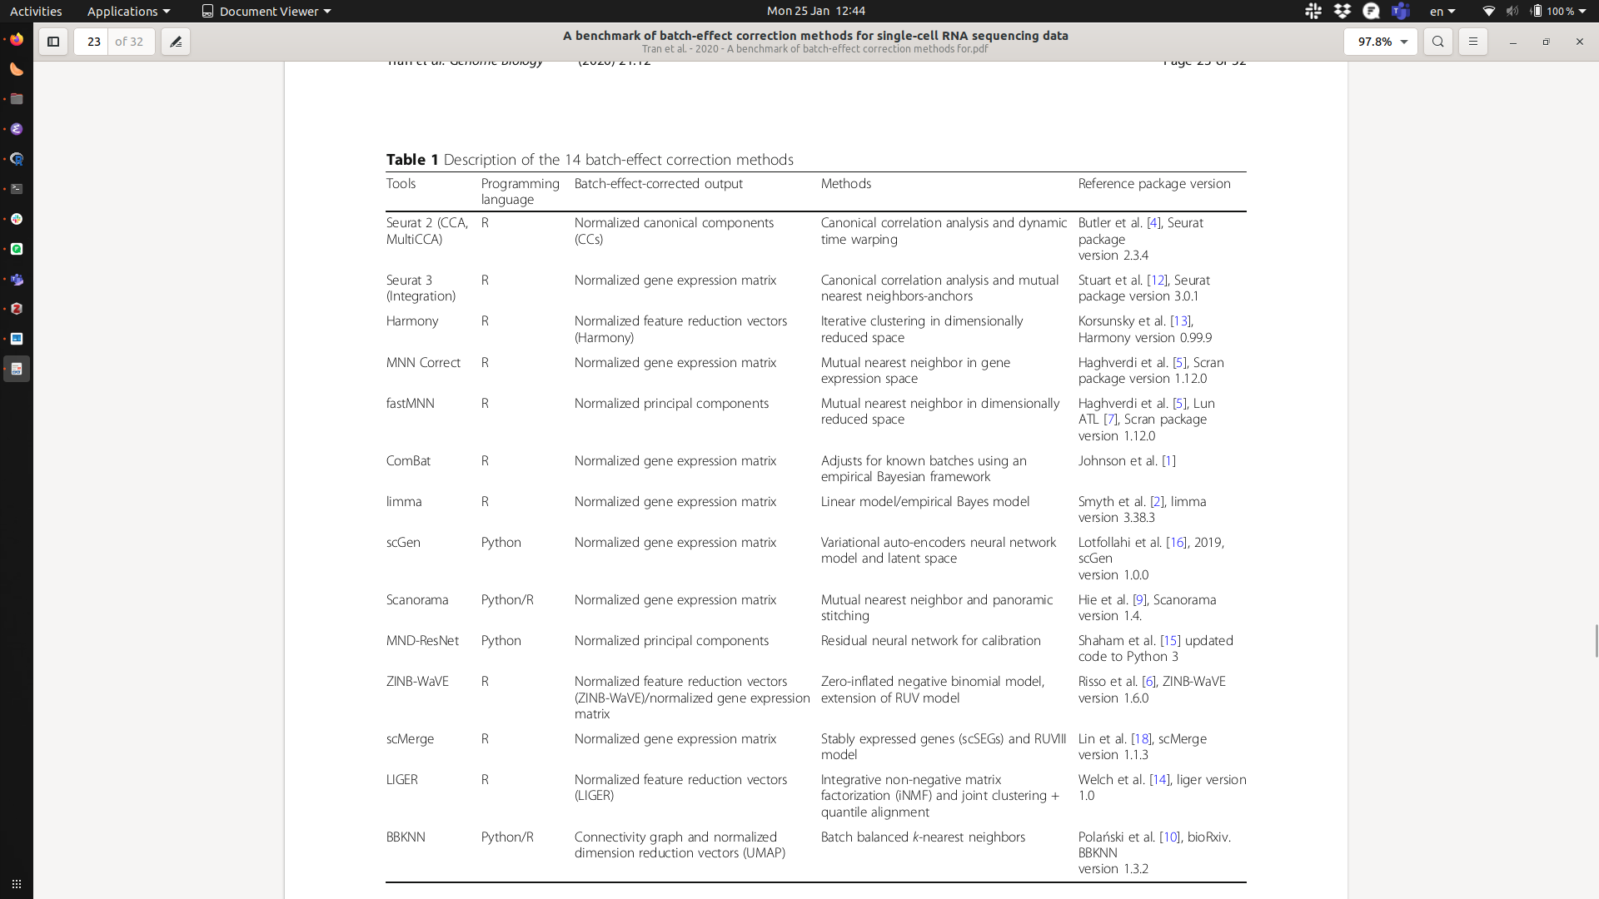
Selected algorithms
Tran et al., Genome Biology, 2020

Slide 4
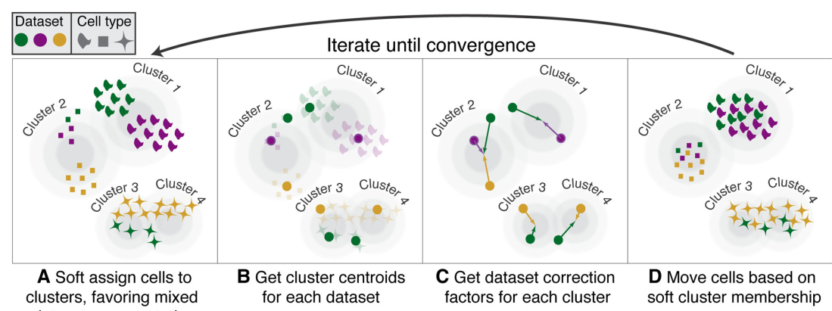
Harmony
PCA ->
-> Harmony
Korsunsky et al, Nature Methods, 2019

Slide 5
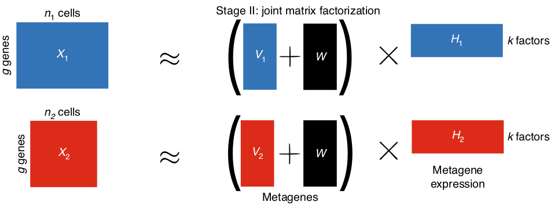
Liger
Welch et al, Cell, 2019
Liu et al, Nature Protocols, 2020

Slide 6
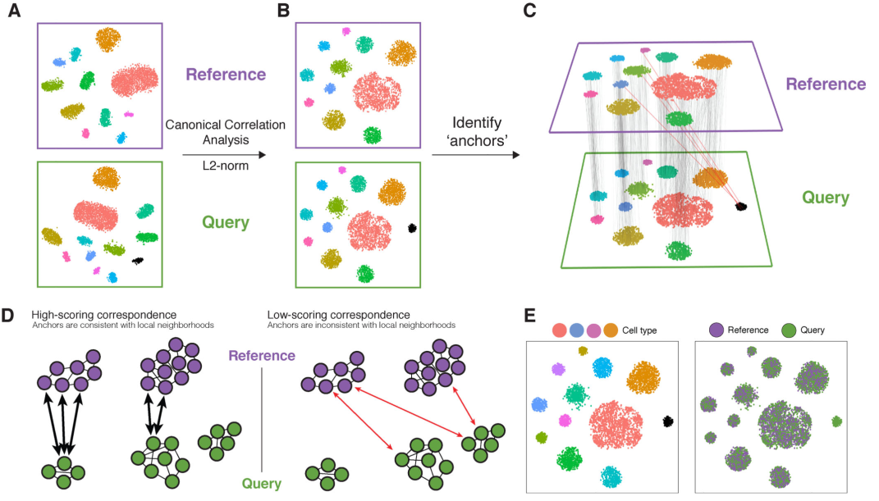
Seurat (v3)
Stuart et al, Cell, 2019

Slide 7
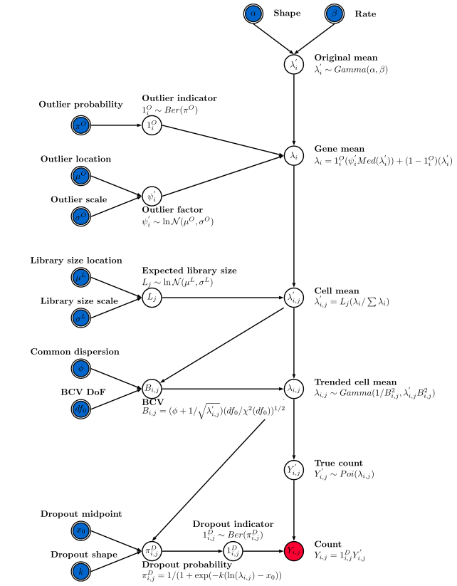
Simulation framework: splatter
multiplied by a (1+log-normal) term for differential expression of a fraction of the genes to simulate cell types
multiplied (1+log-normal) term across all genes for batch effects
multiplied by an interpolated (1+log-normal) term across a fraction of the genes for trajectories
Zappia et al, Genome Biology, 2017

Slide 8
Questions adressed
Sensitivity: are the different algorithms able to correct for batch effects?
Specificity: Do they accurately retain biological variation? Do they preserve discrete cell identities? Continuums?
Do they scale well with increasing numbers of batches?

Slide 9
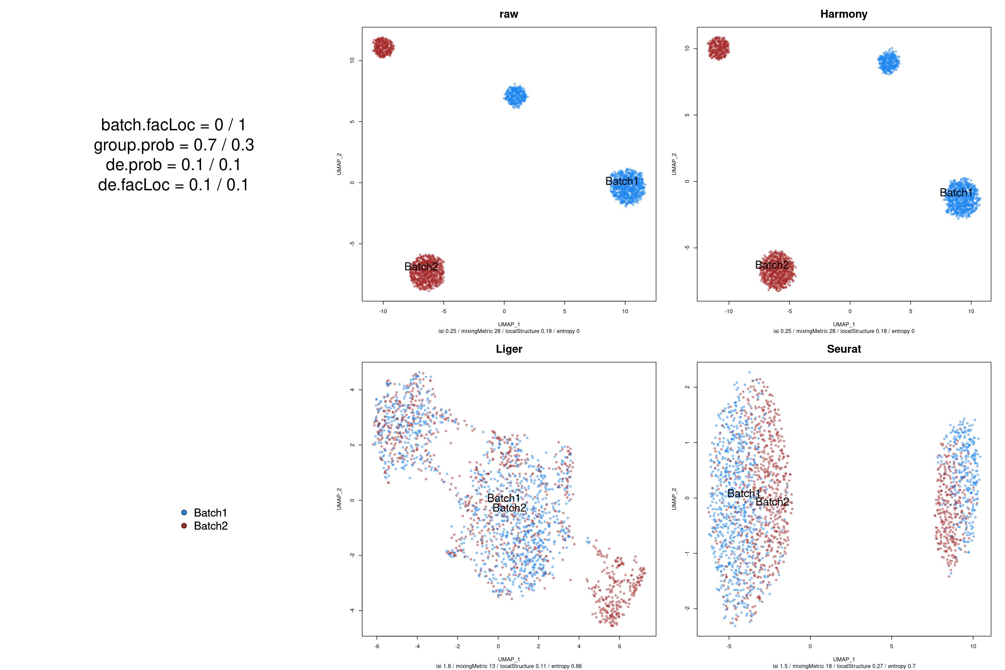
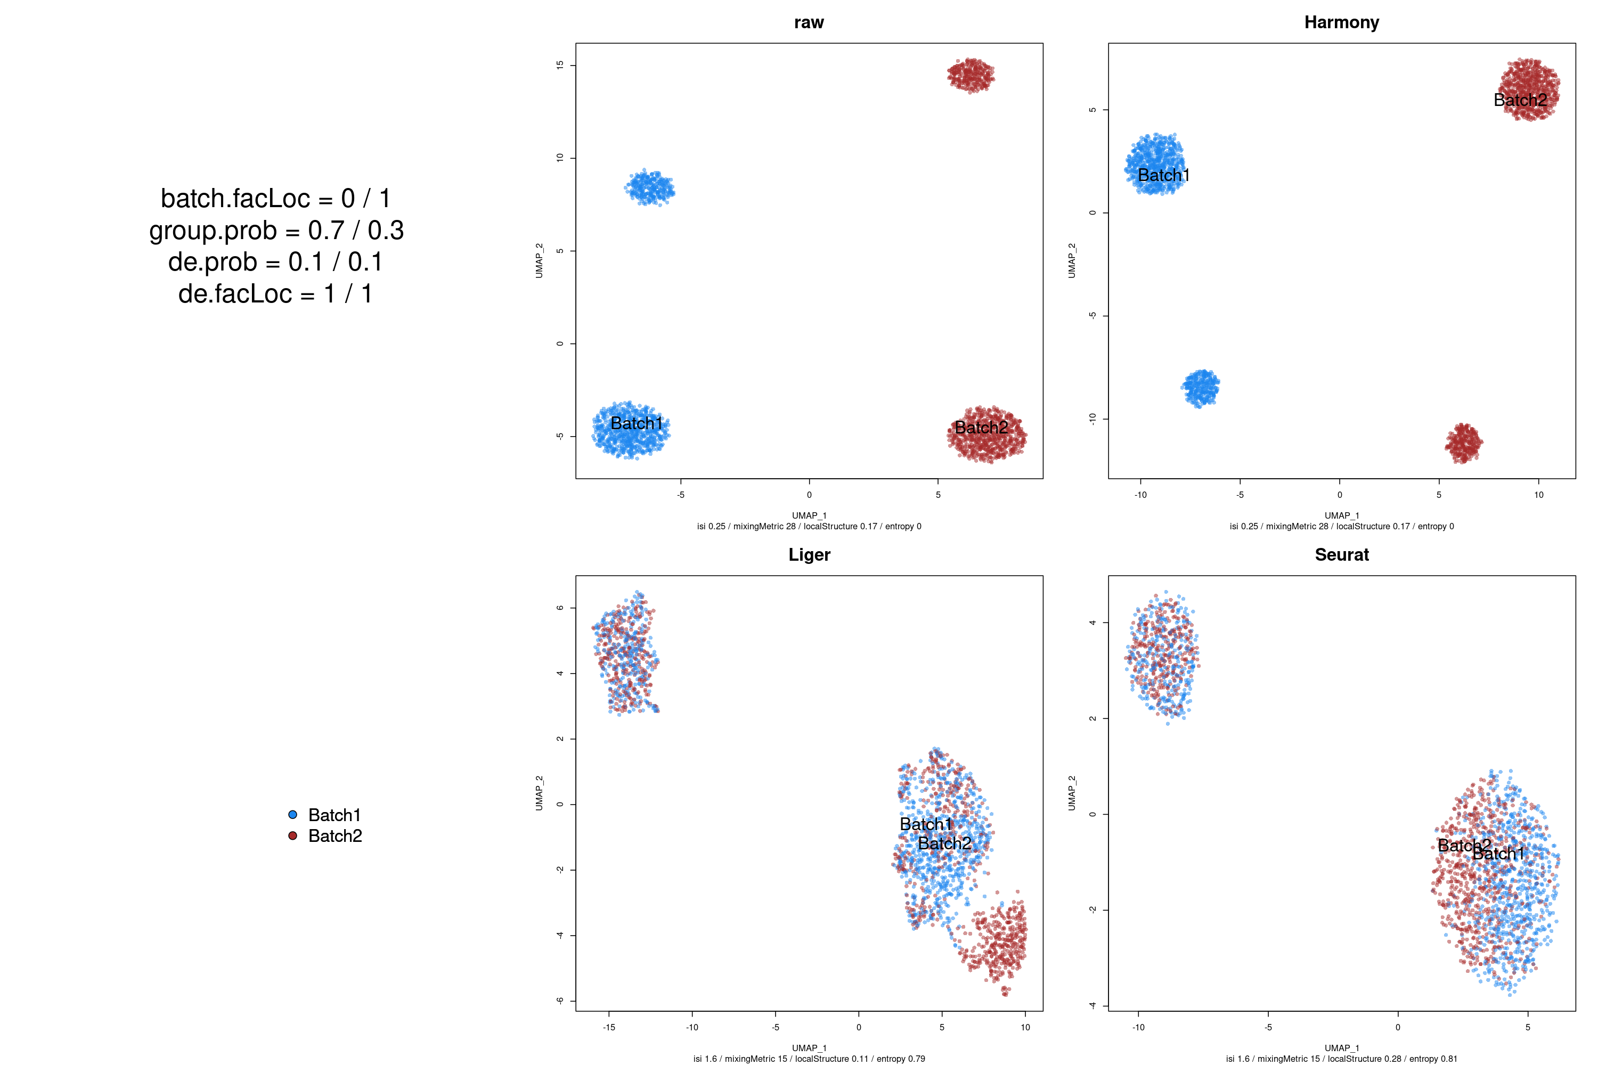
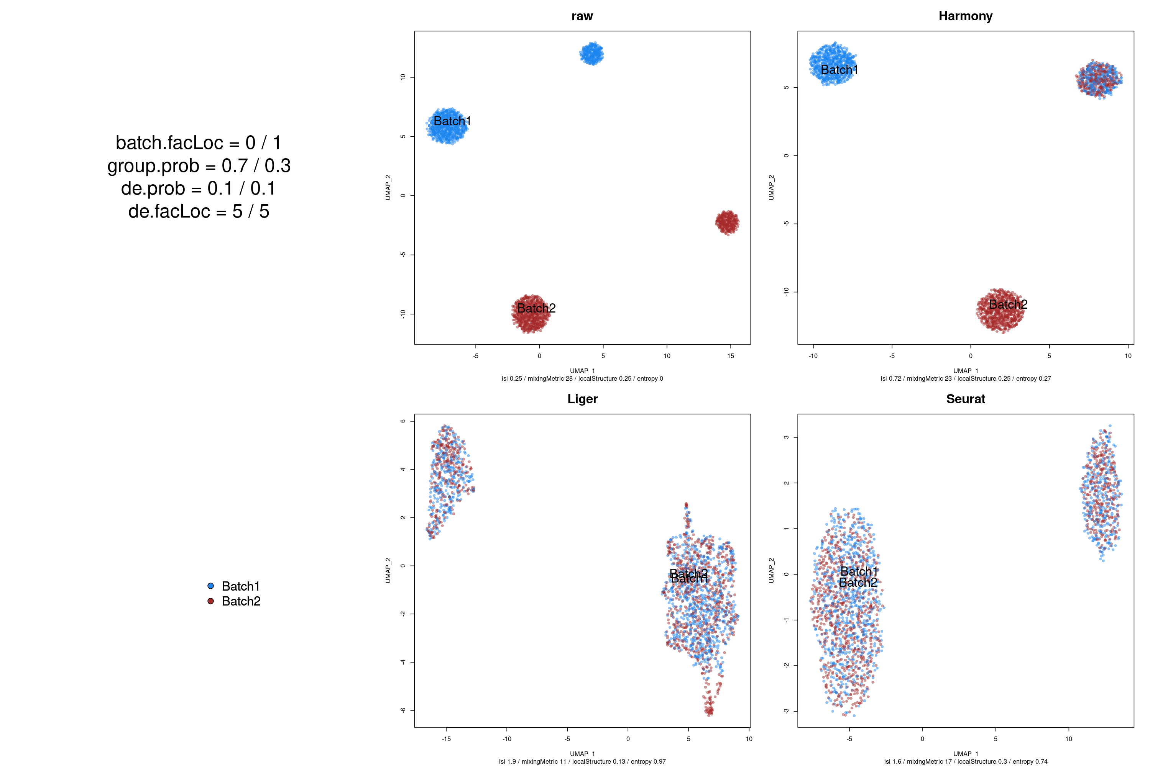
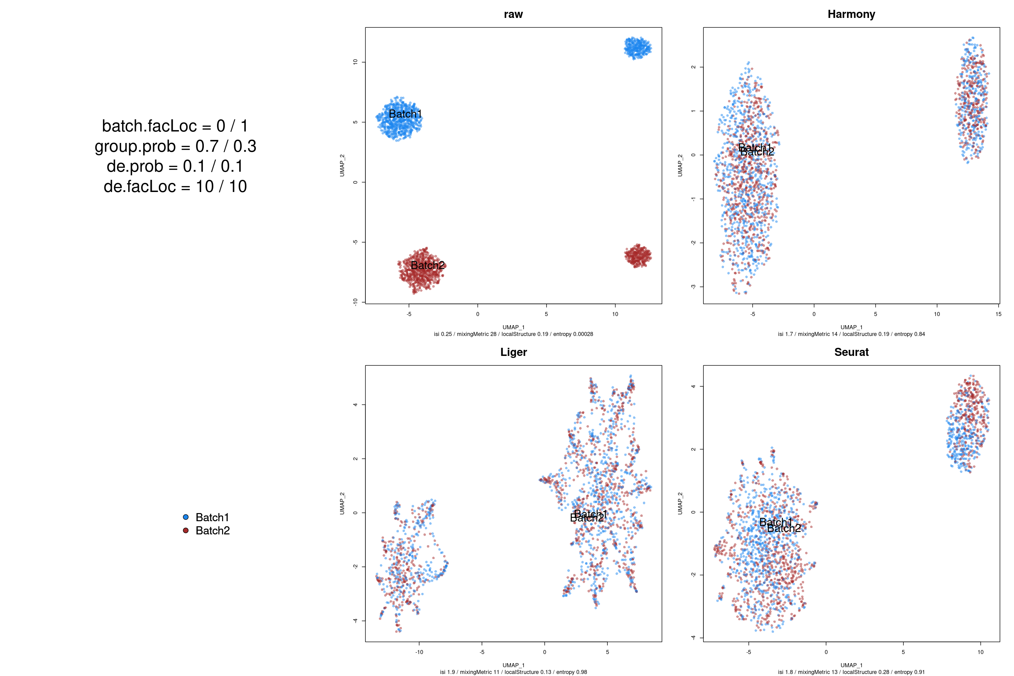
“Cell type” effect size
0.1
1
5
10
Raw
Truth
Harmony
UMAP2
UMAP1
Liger
Seurat

Slide 10
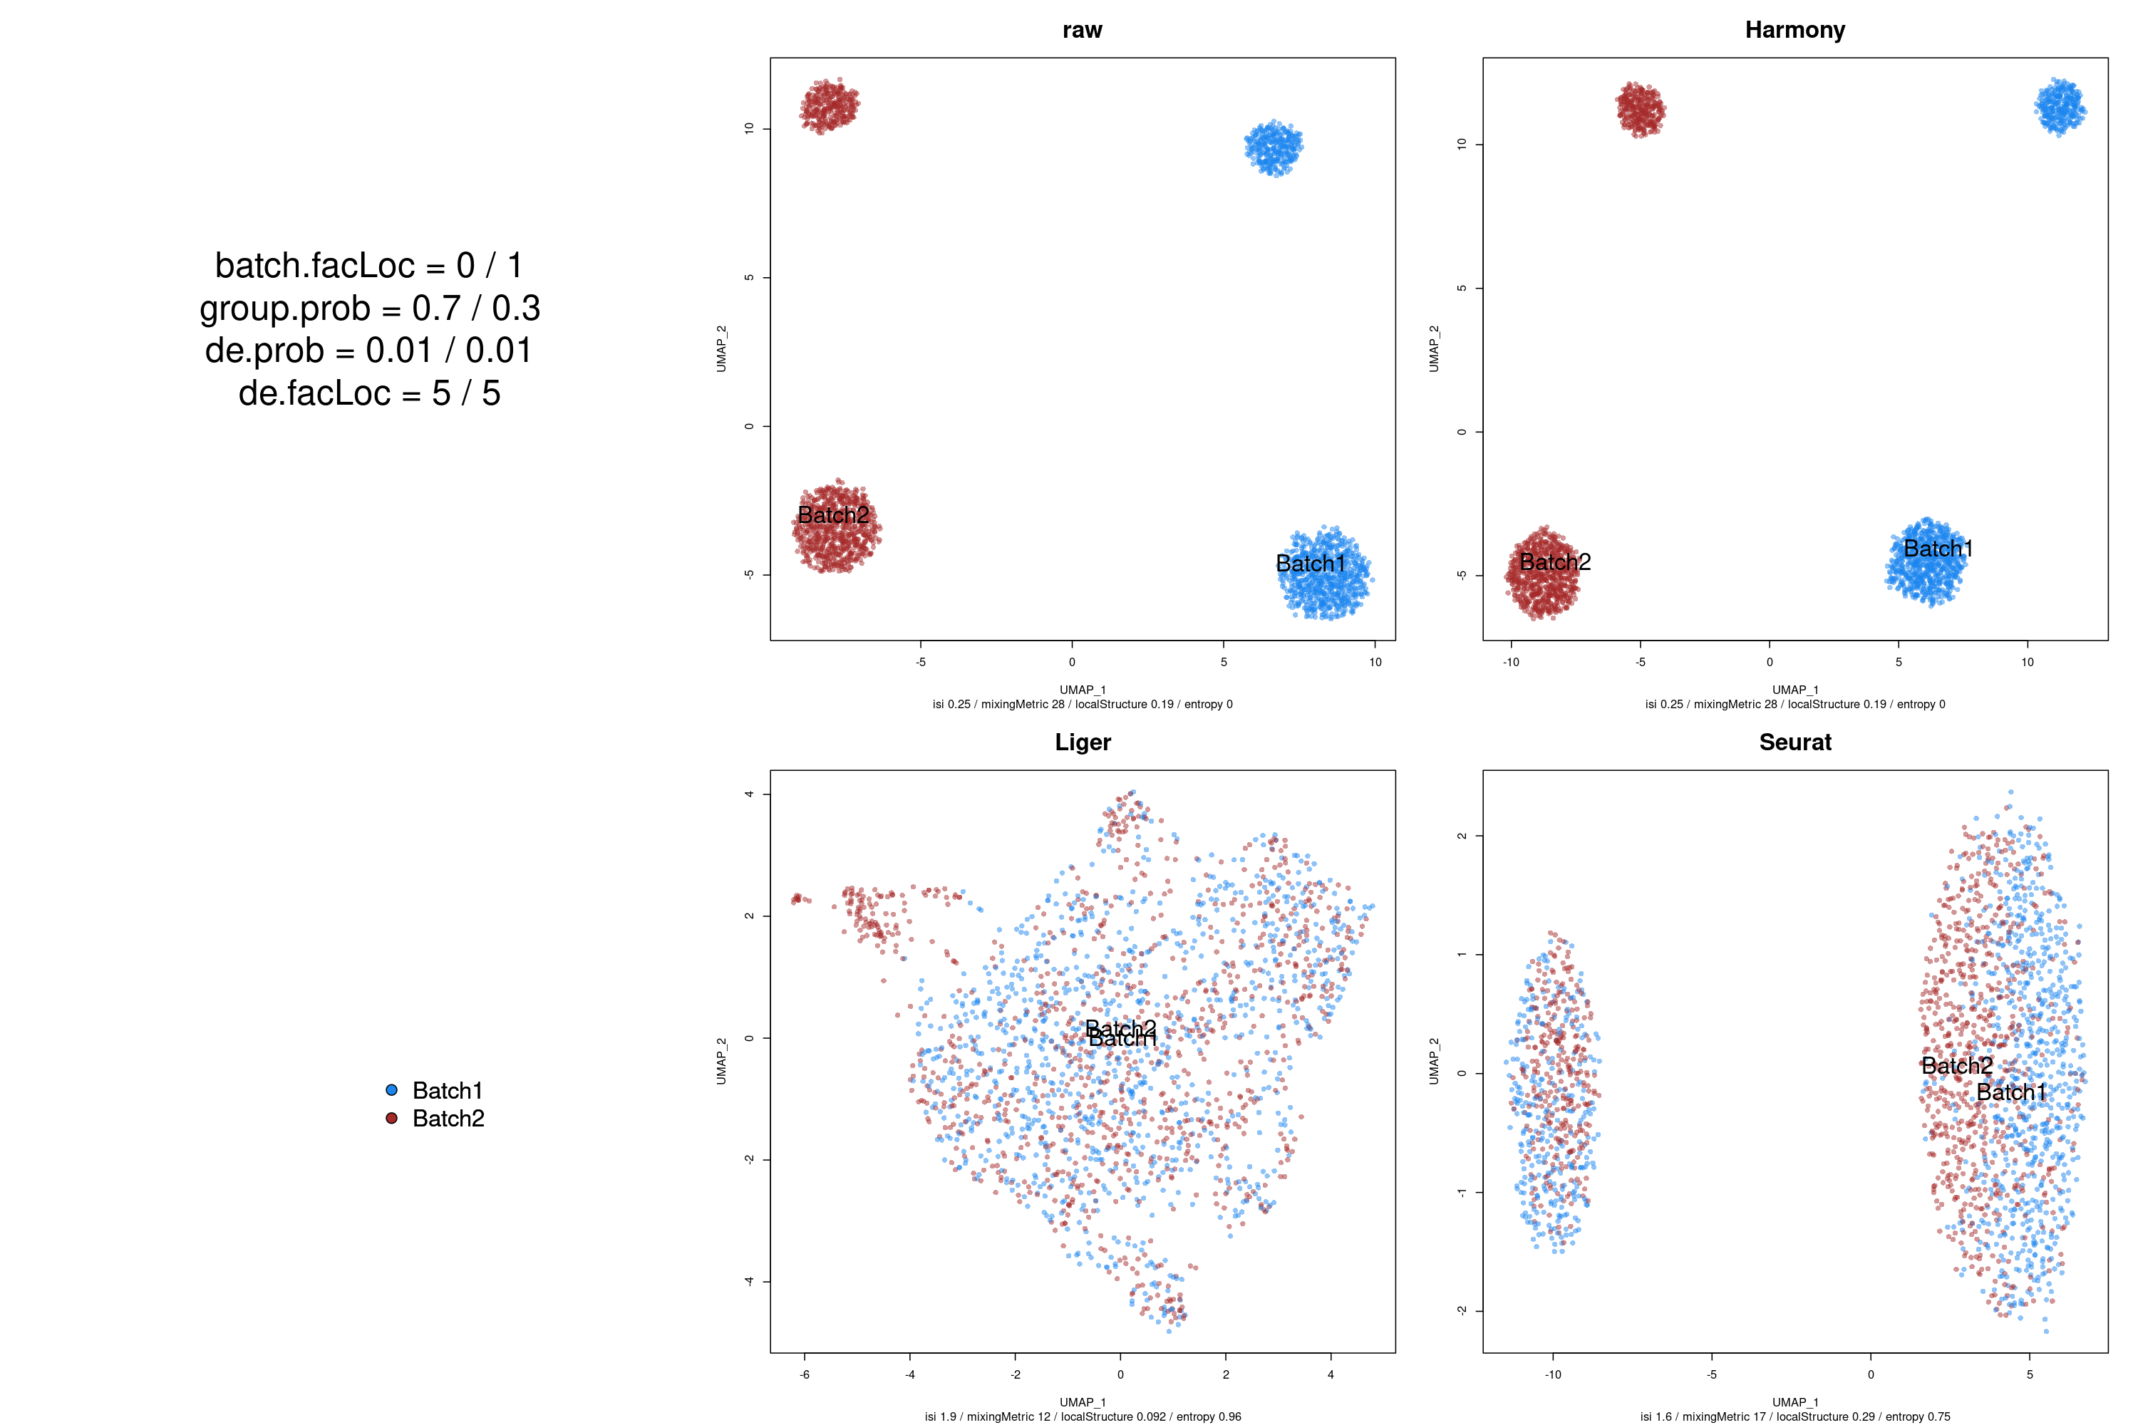

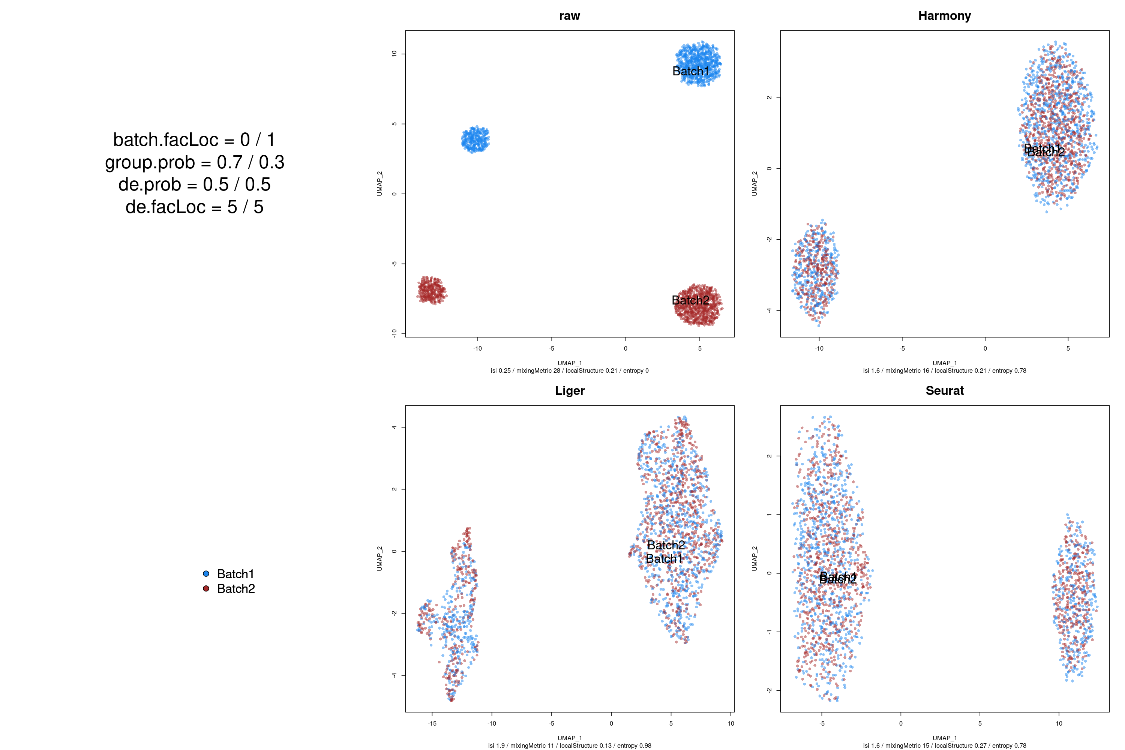
Frequency of differentially-expressed genes
0.01
0.1
0.5
Raw
Truth
Harmony
UMAP2
UMAP1
Liger
Seurat

Slide 11
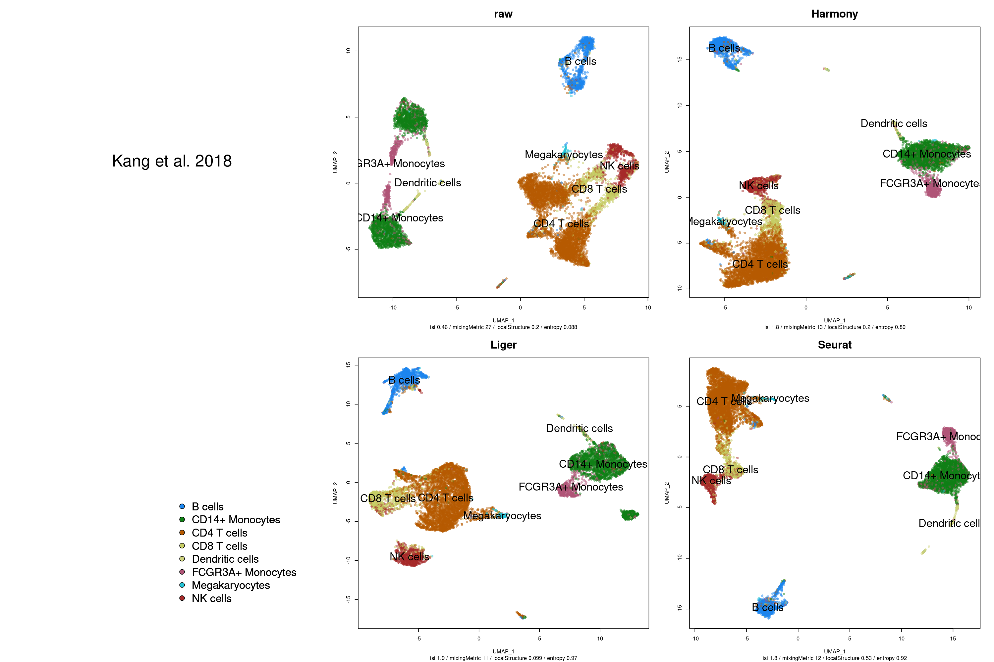
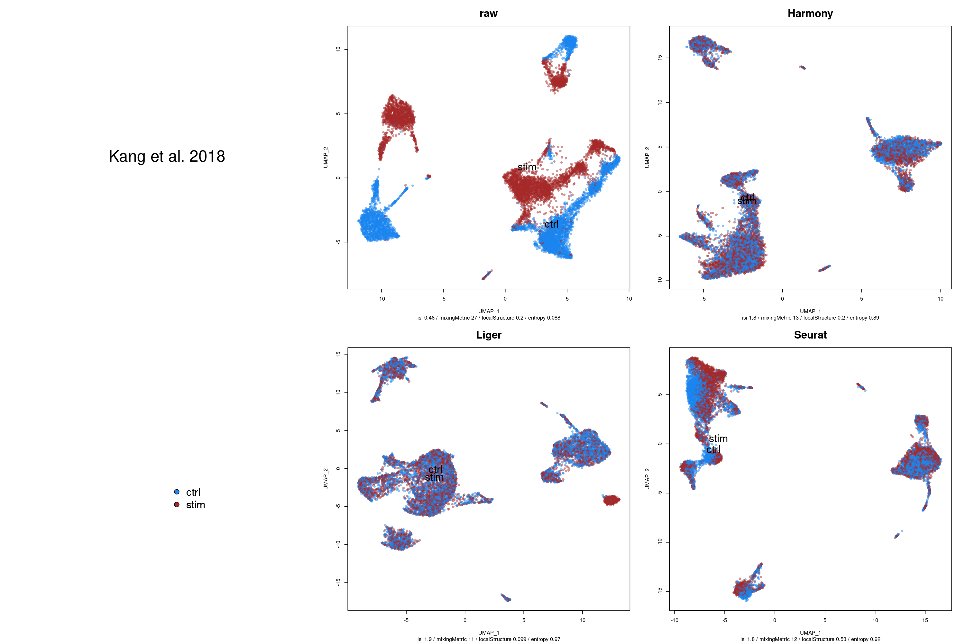
Kang et al. dataset: PBMCs, two conditions
Notes:
“High cell-type effect, low batch effect”
Does it make sense to fully regress-out the conditions? Is that residual batch effect on Seurat meaningful?

Slide 12
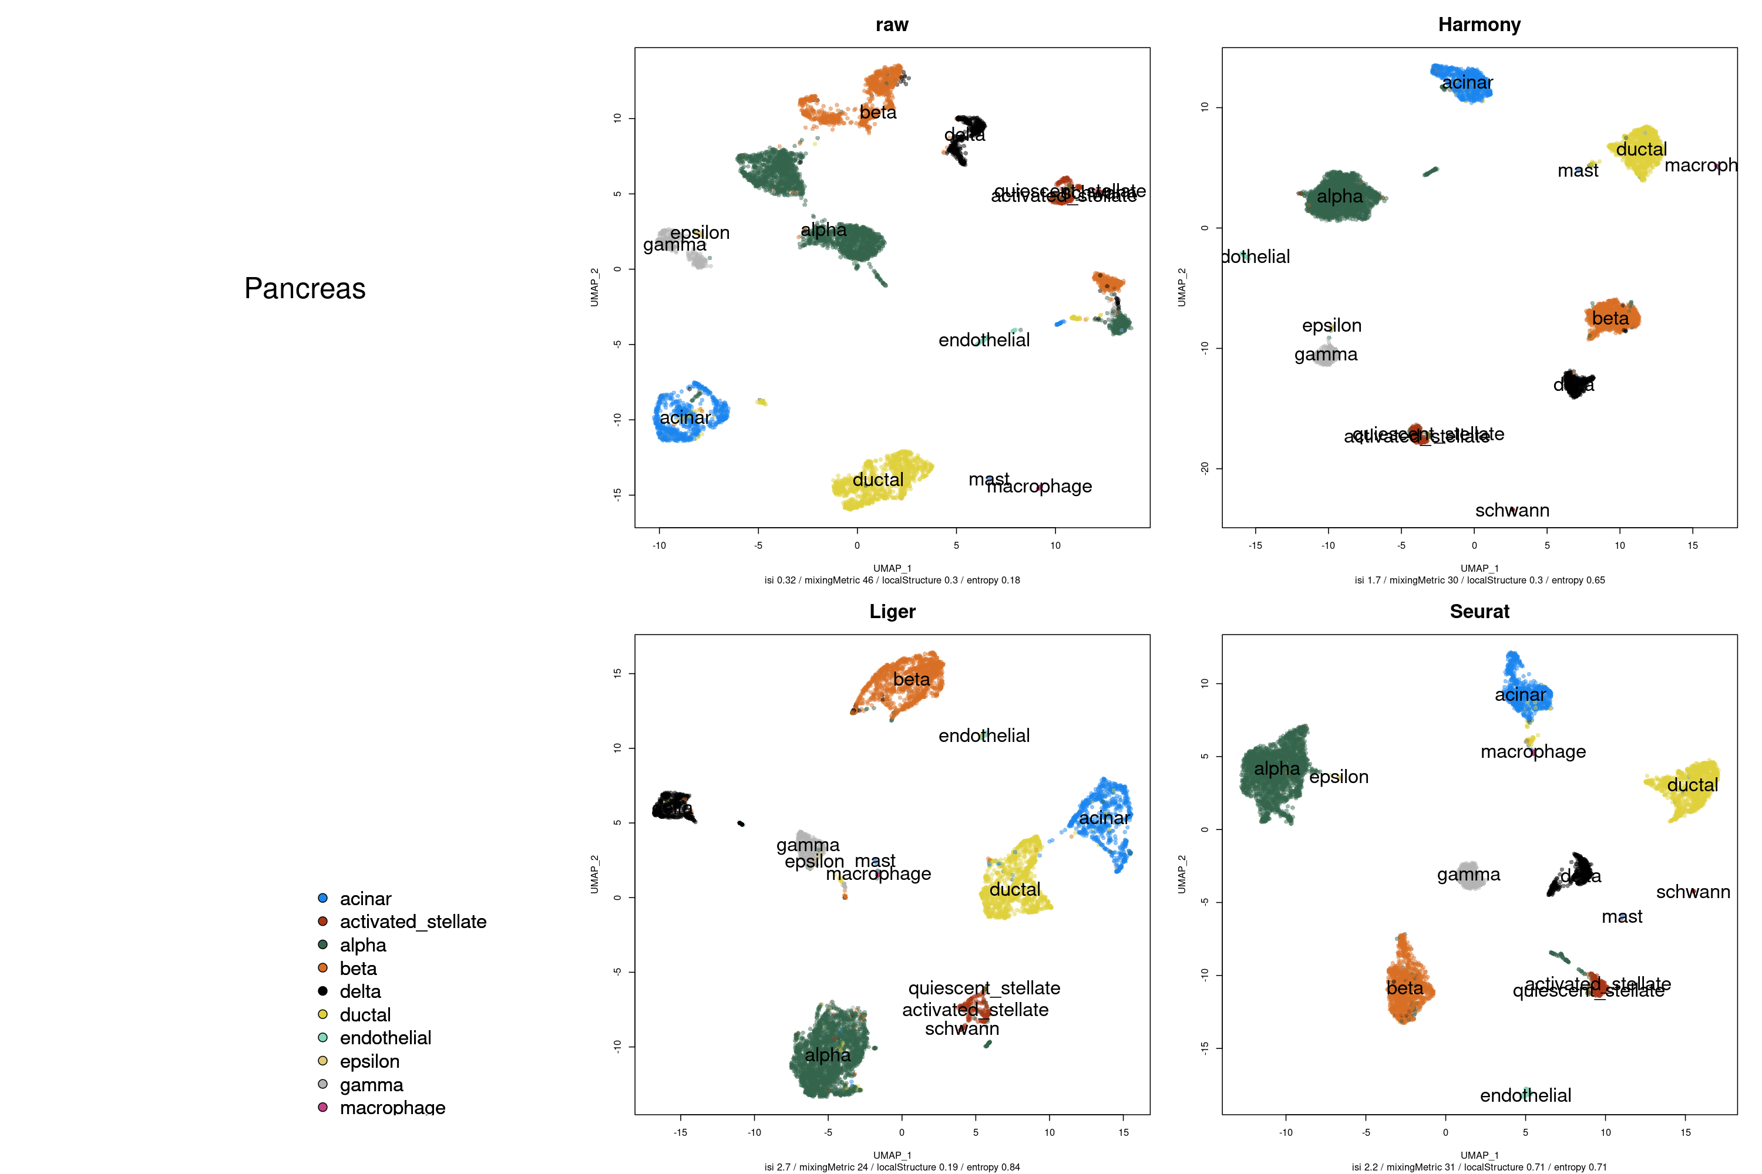
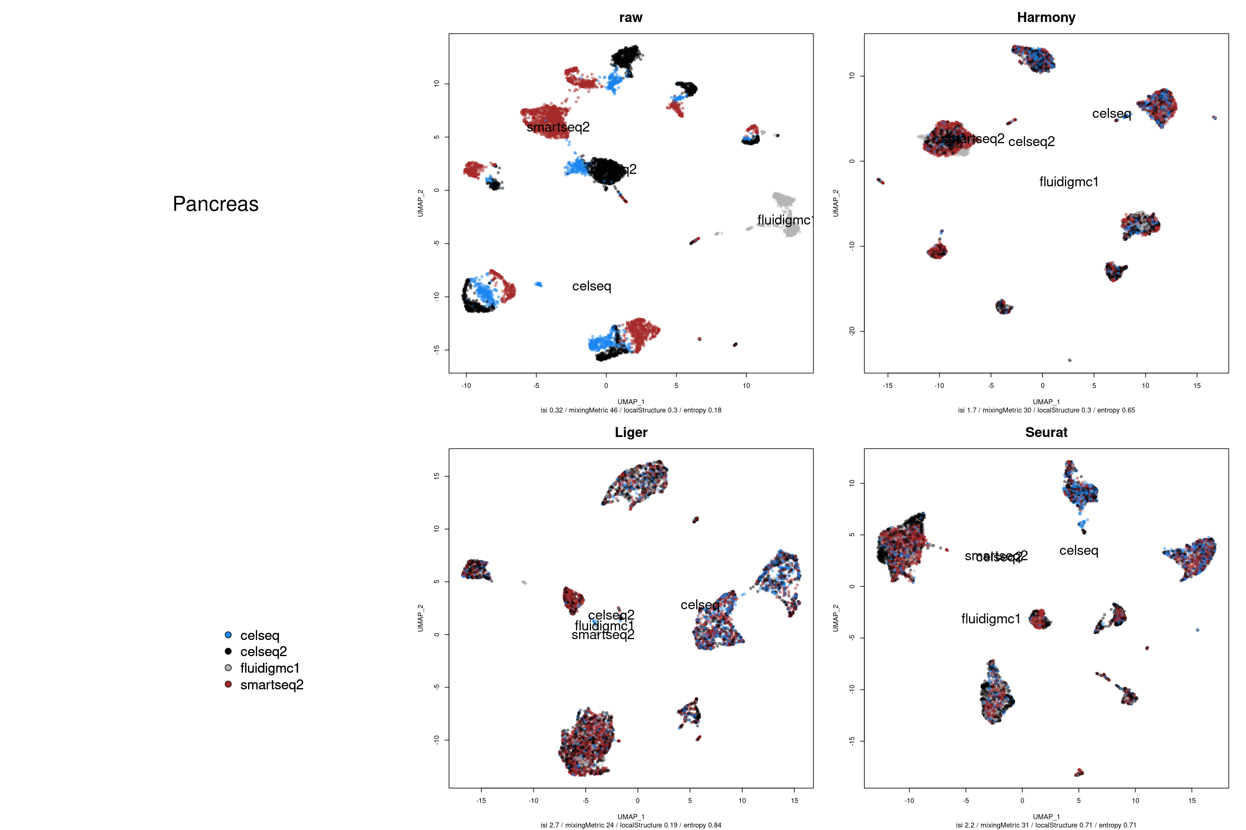
Human pancreas - many cell types, 4 scRNAseq protocols
Notes:
Small batch effect - strong cell type effect. Excepted for Fluidigm C1

Slide 13
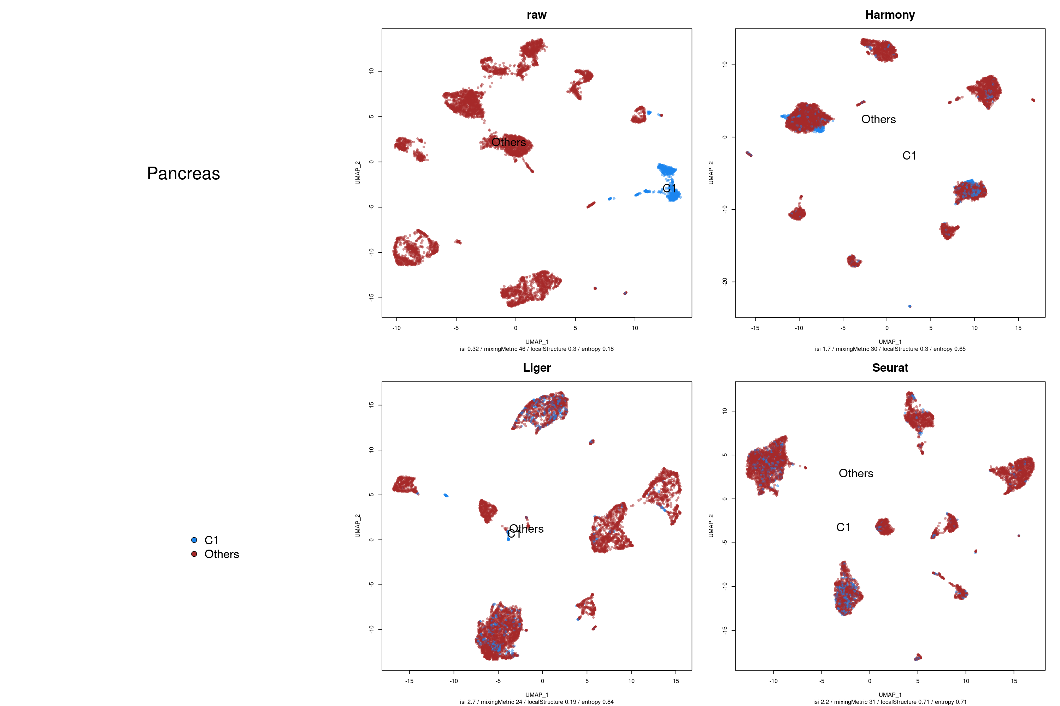
Human pancreas - many cell types, 4 scRNAseq protocols
Notes:
Fluidigm C1 still accurately dispatched by each method. The match effect is likely different from the one in the simulation (dropout)

Slide 14
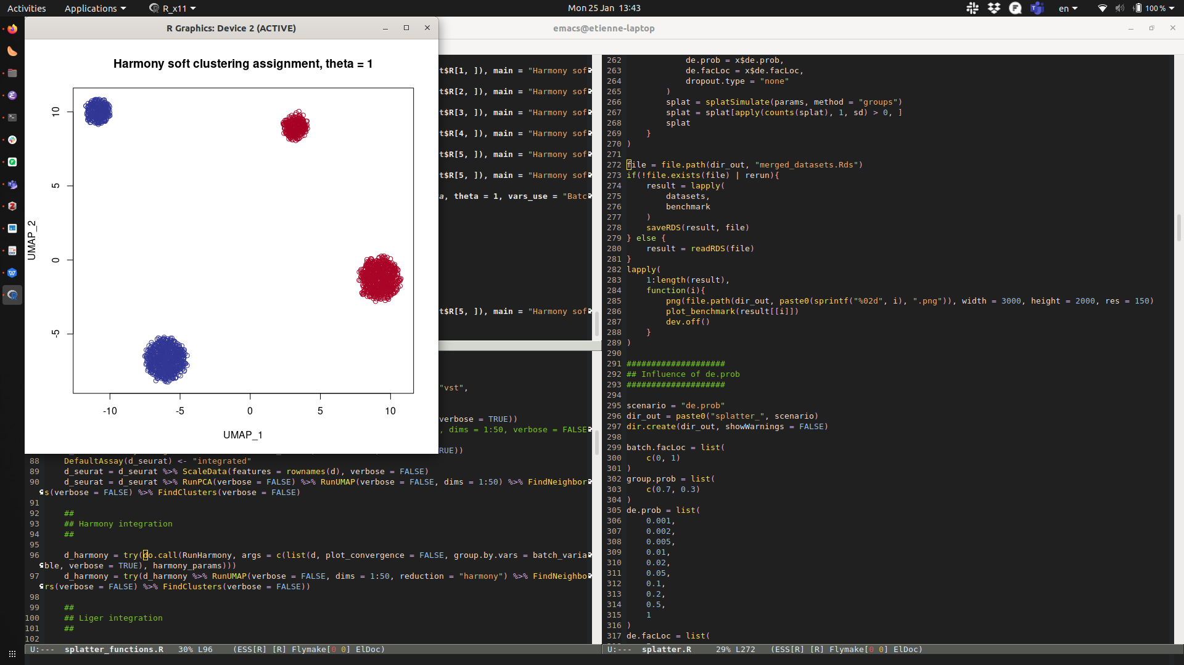
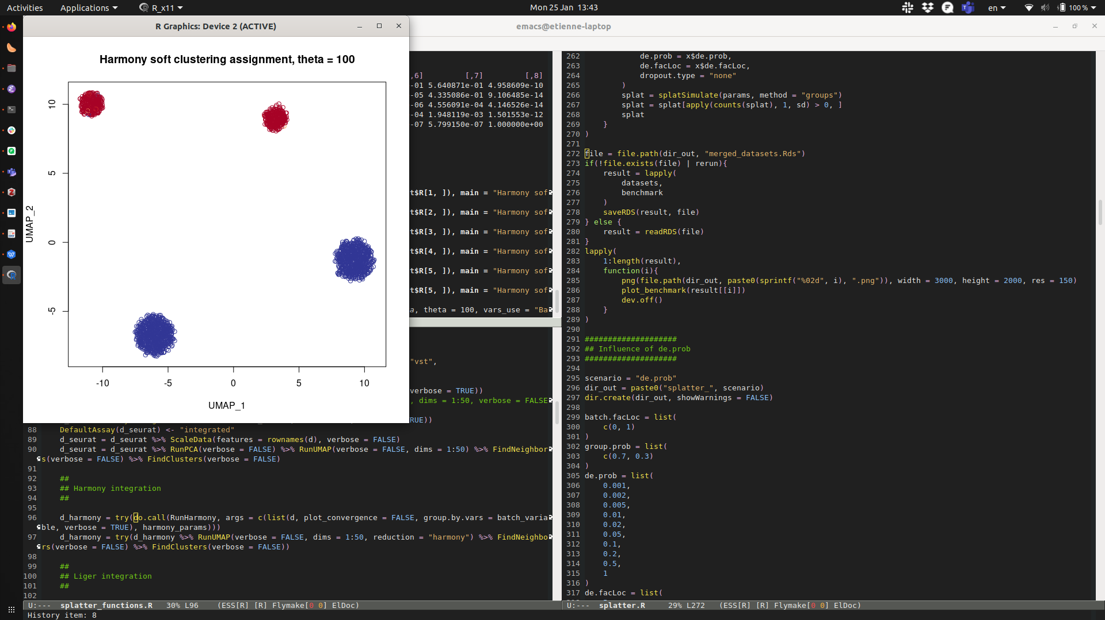
Conclusions on DEG effect sizes and frequency
The real datasets generally have “low” batch effects compared to cell types effects
Seurat appears to be the most sensitive method.
Liger sometimes undercorrects or overcorrects (retains a residual batch effect or obfuscates a cell-type effect)
Harmony the least sensitive (can be forced to merge the datasets by tweaking a parameter):
soft-clustering
by cell type
soft-clustering
by batch
Notes:
theta penalizes for clusters’ homogeneity

Slide 15
Questions adressed
Sensitivity: are the different algorithms able to correct for batch effects?
Specificity: Do they accurately retain biological variation? Do they preserve discrete cell identities? Continuums?
Do they scale well with increasing numbers of batches?

Slide 16
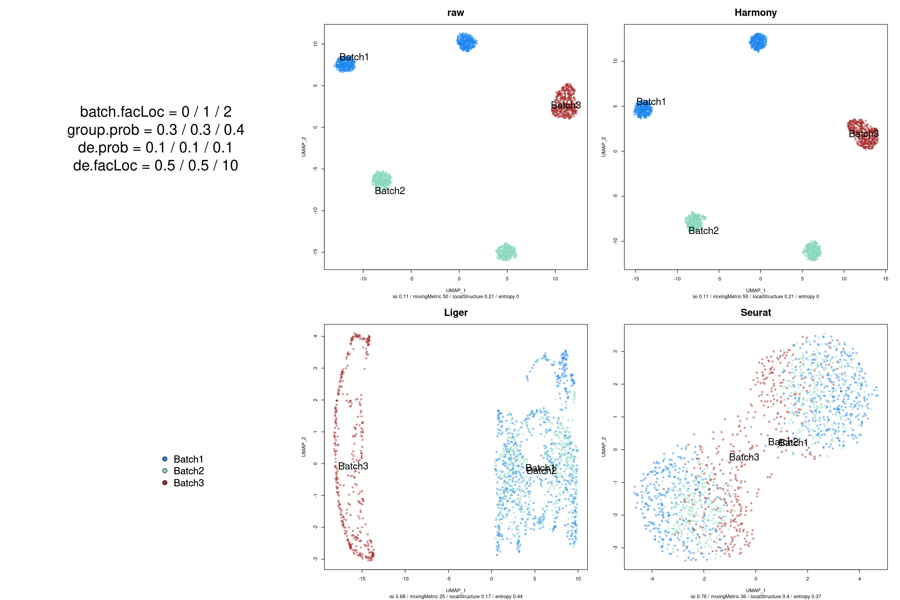
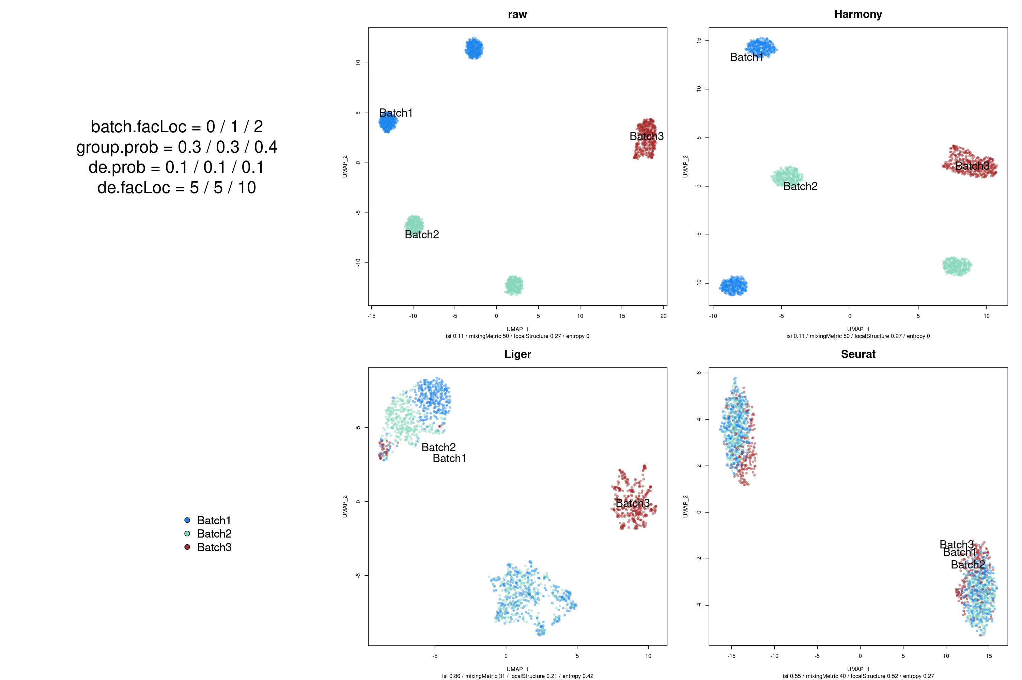
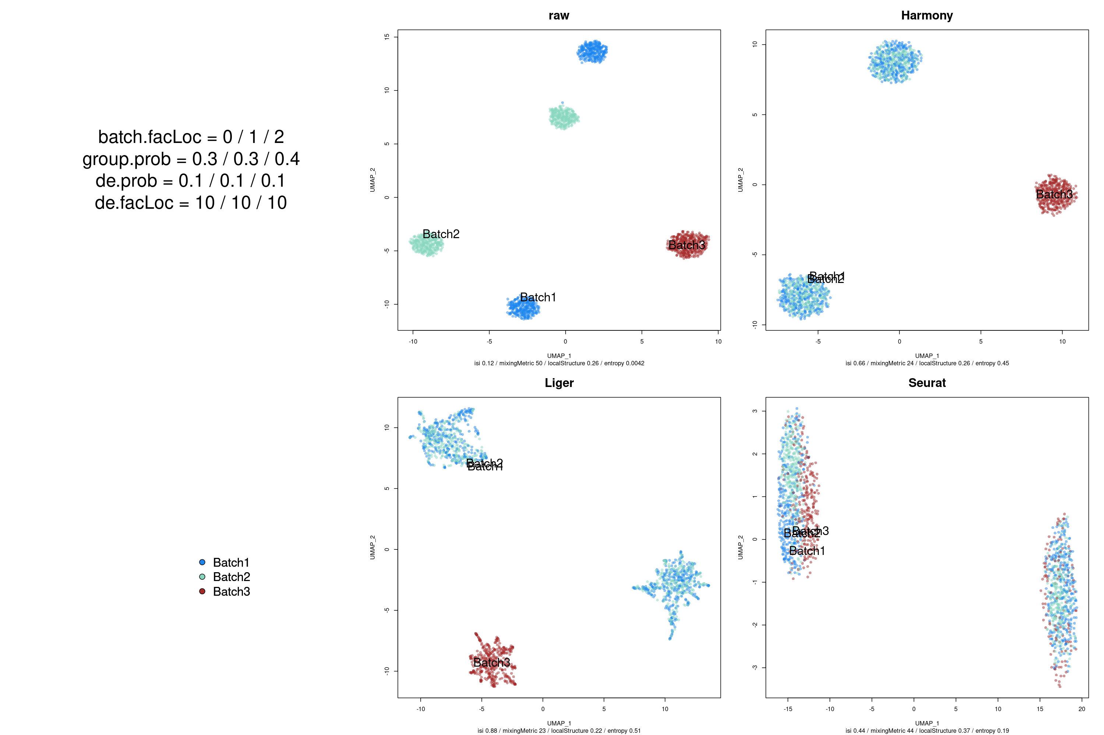
Extra unrelated batch: negative control simulation
0.5
5
10
Raw
Truth
Harmony
UMAP2
UMAP1
Liger
Seurat

Slide 17
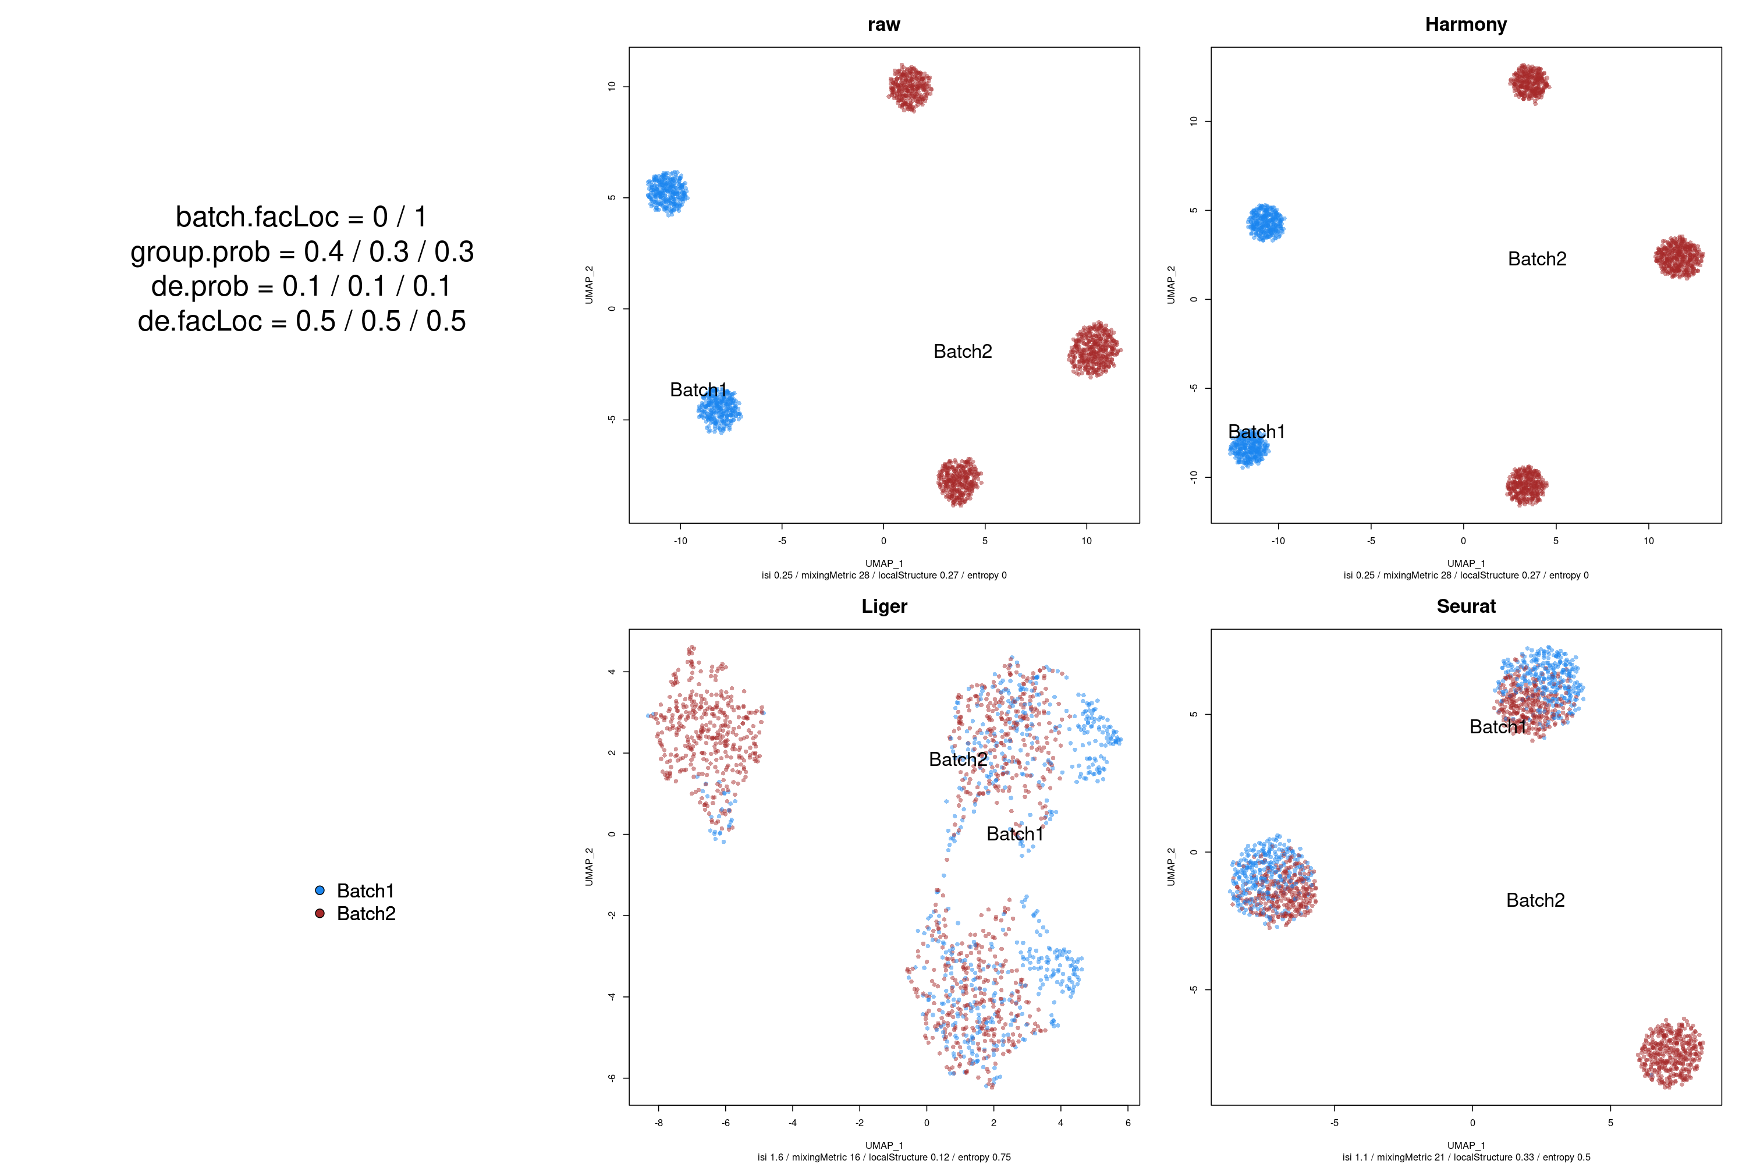
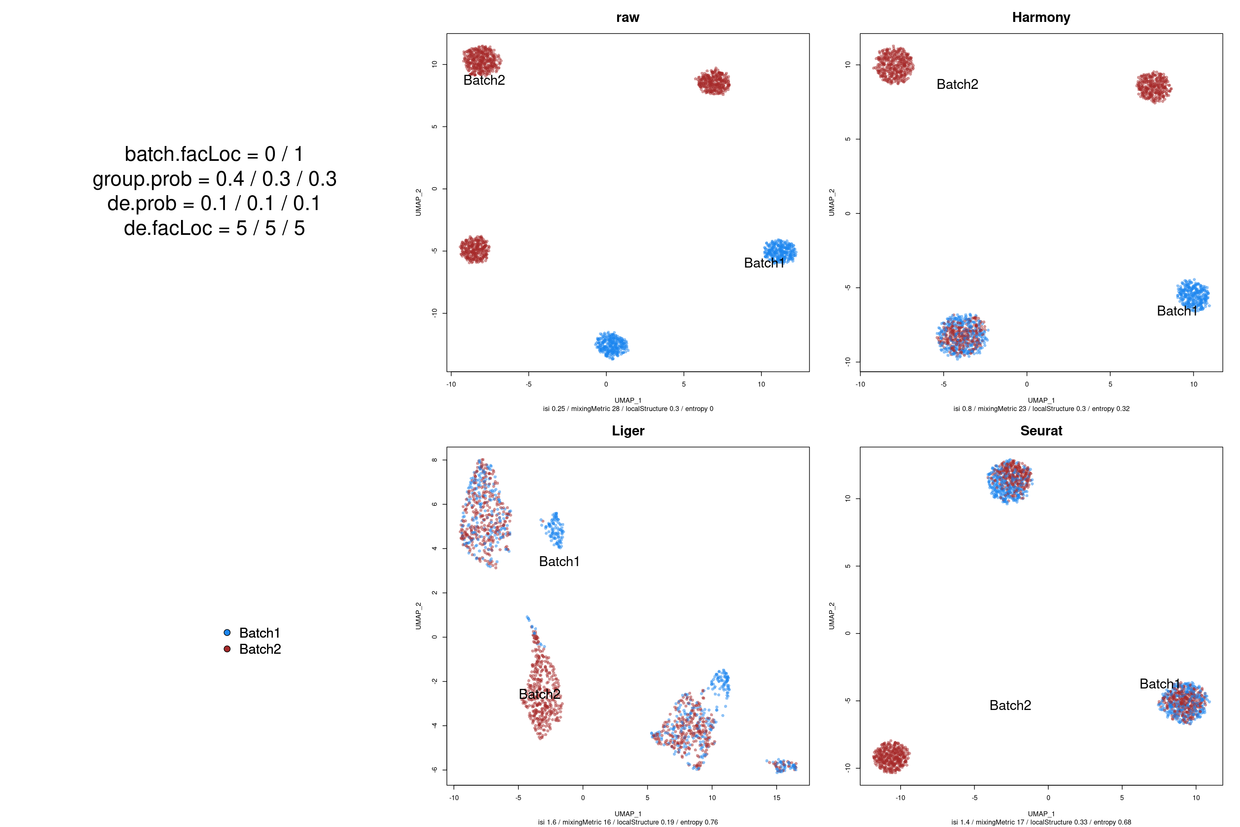
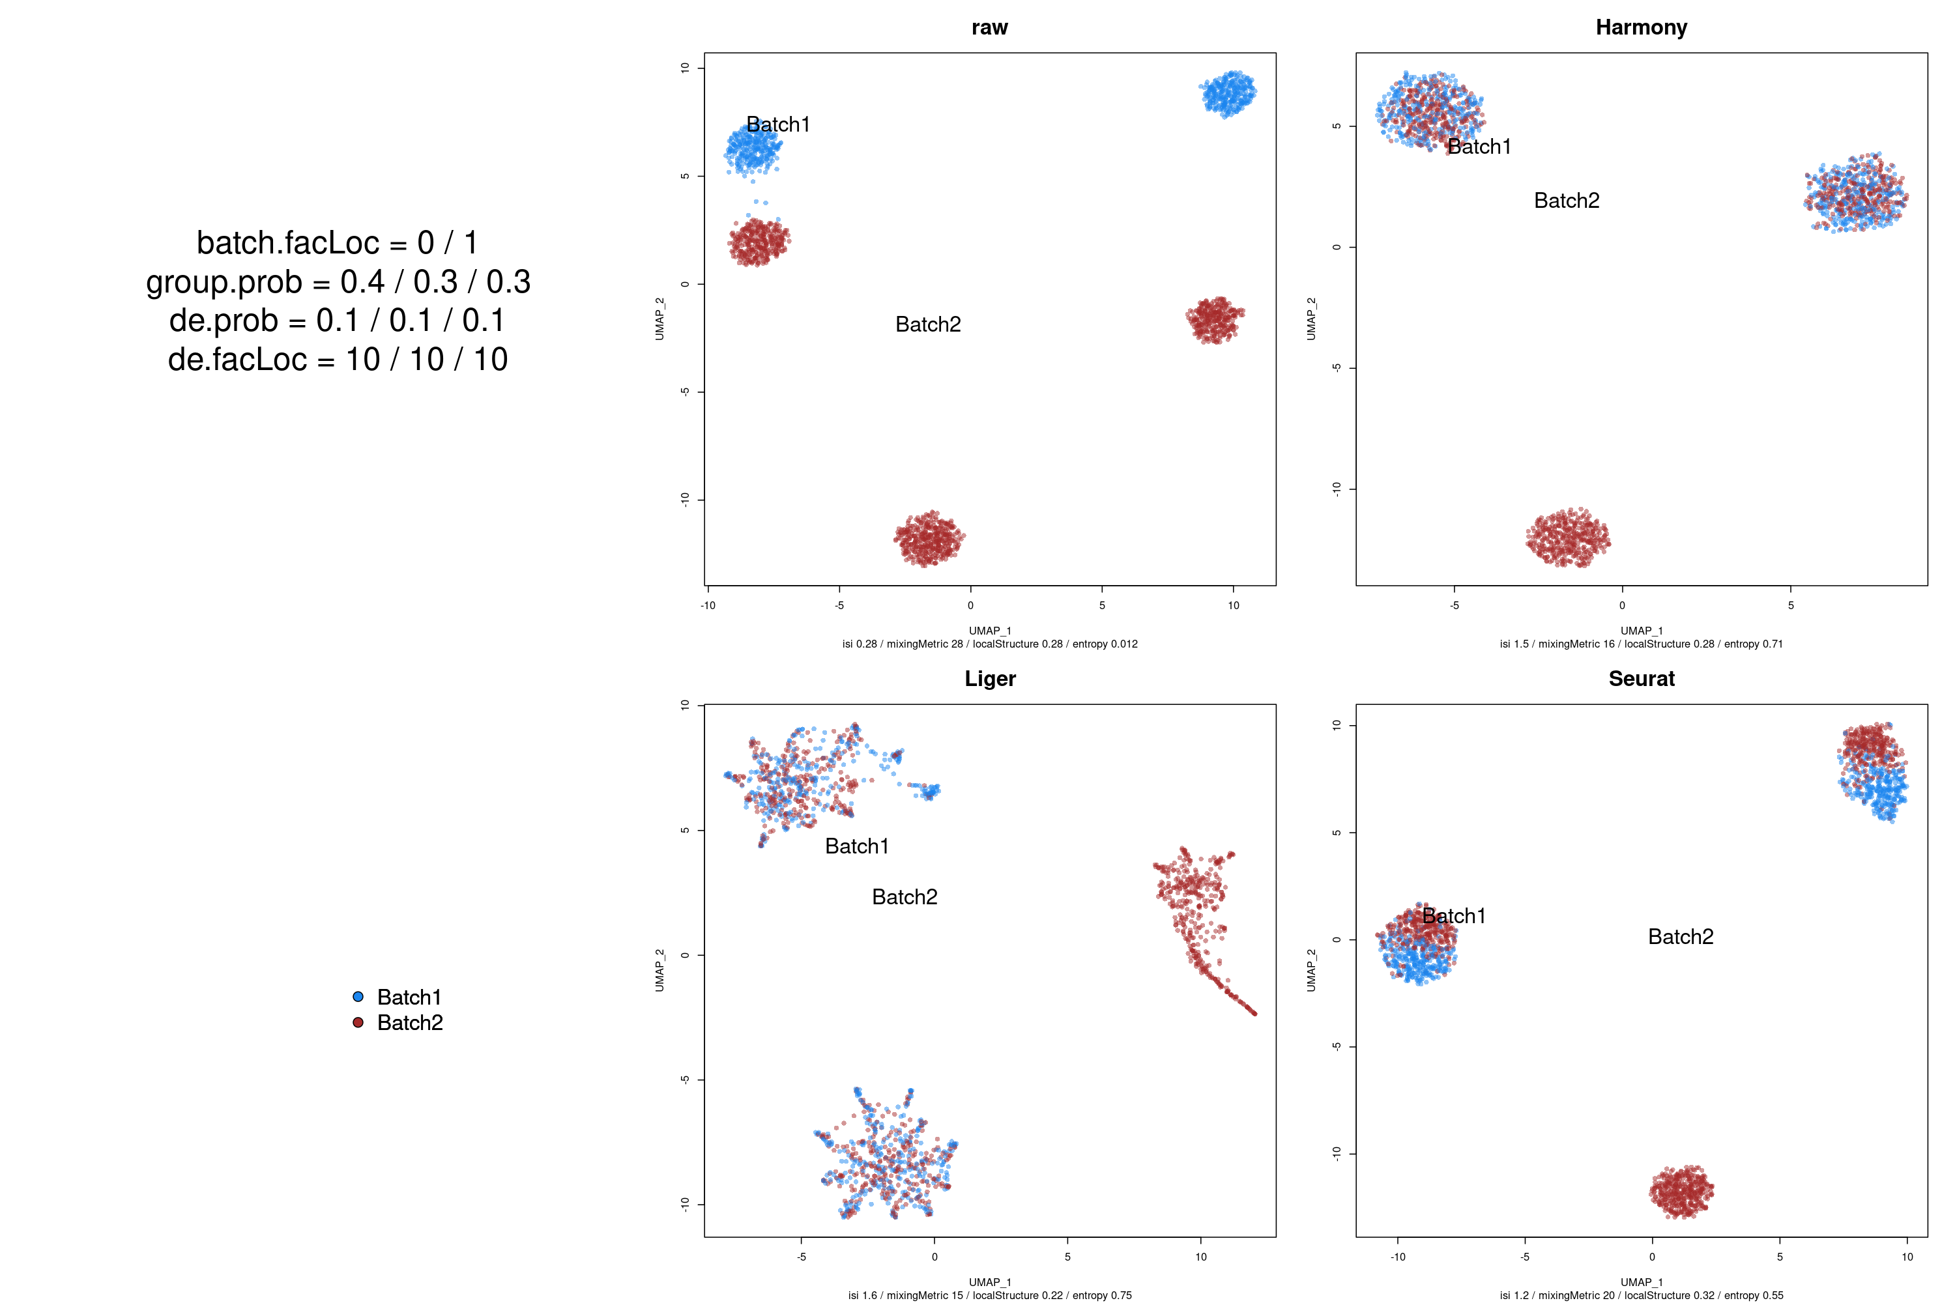
Missing celltype in one batch: negative control experiment
0.5
5
10
Raw
Truth
Harmony
UMAP2
UMAP1
Liger
Seurat

Slide 18
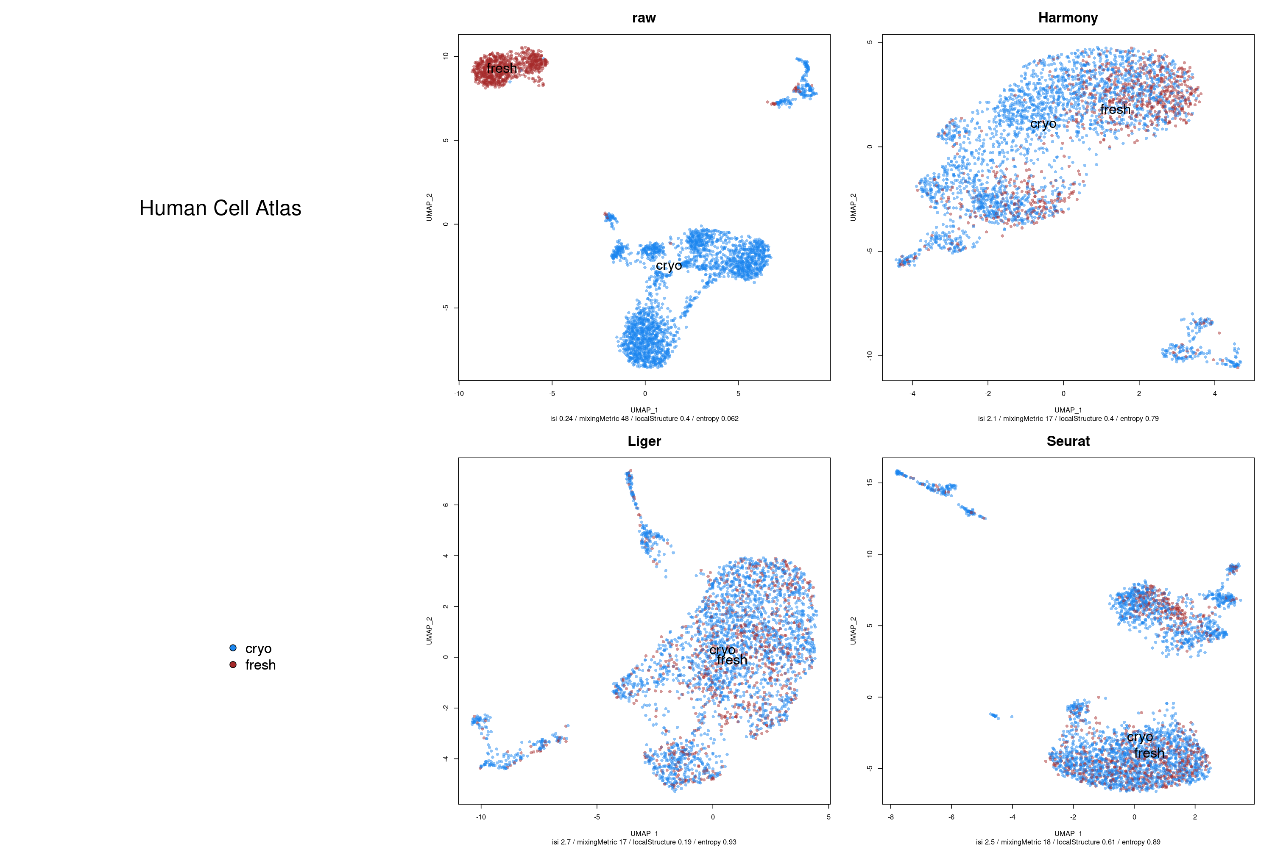
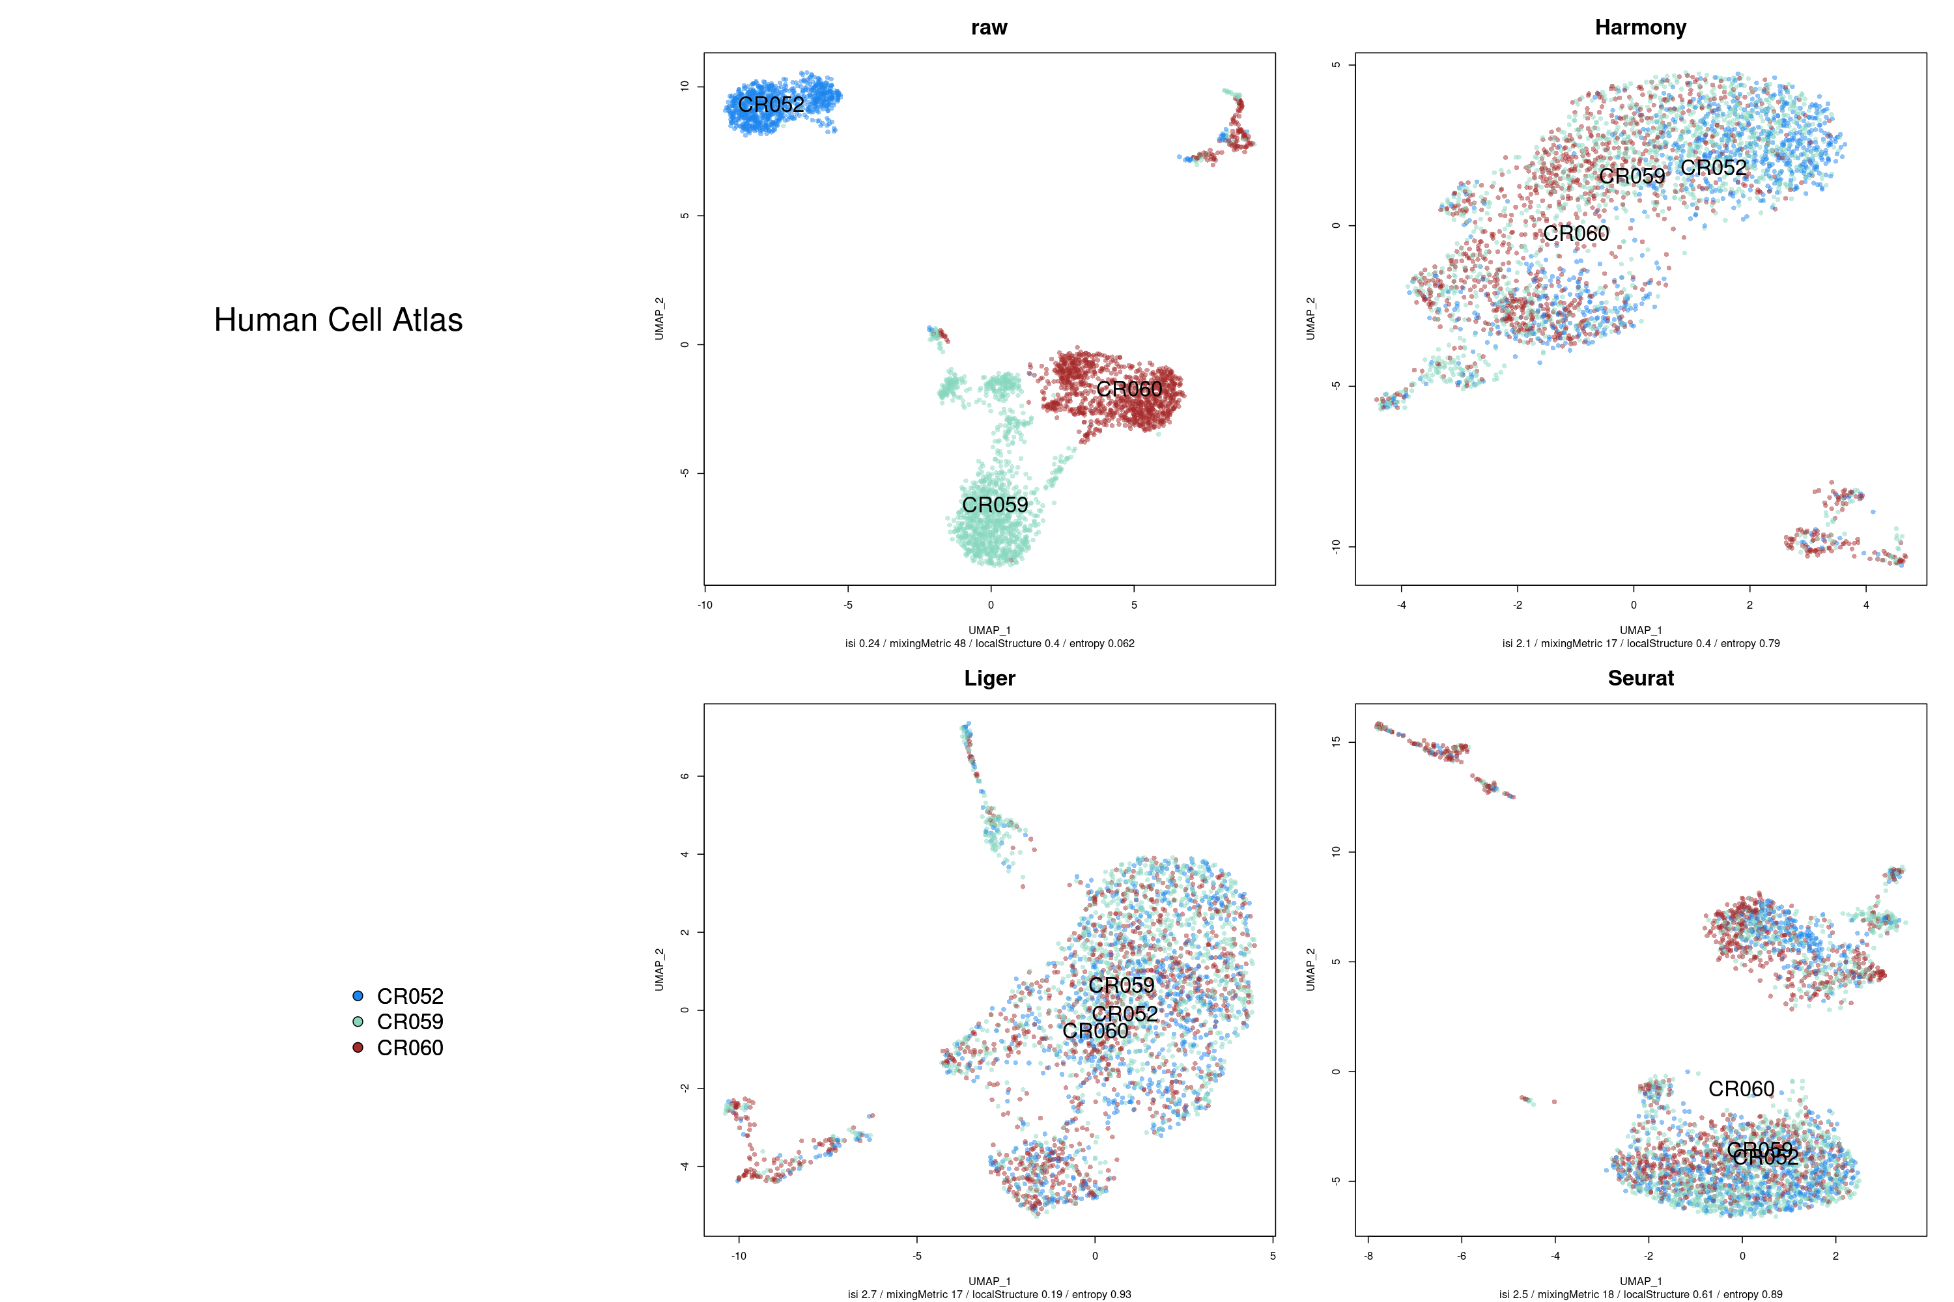
Roche dataset - PBMC, three patients, two conditions

Slide 19
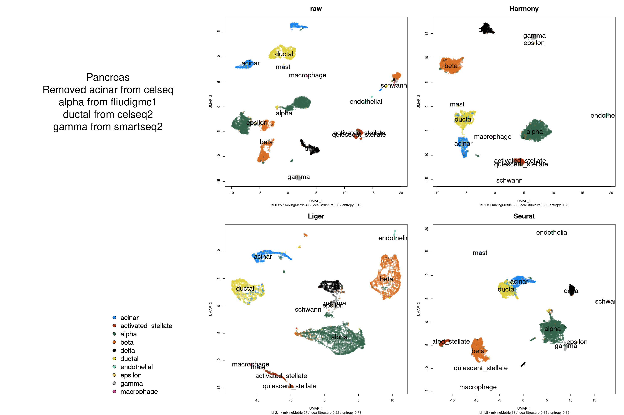
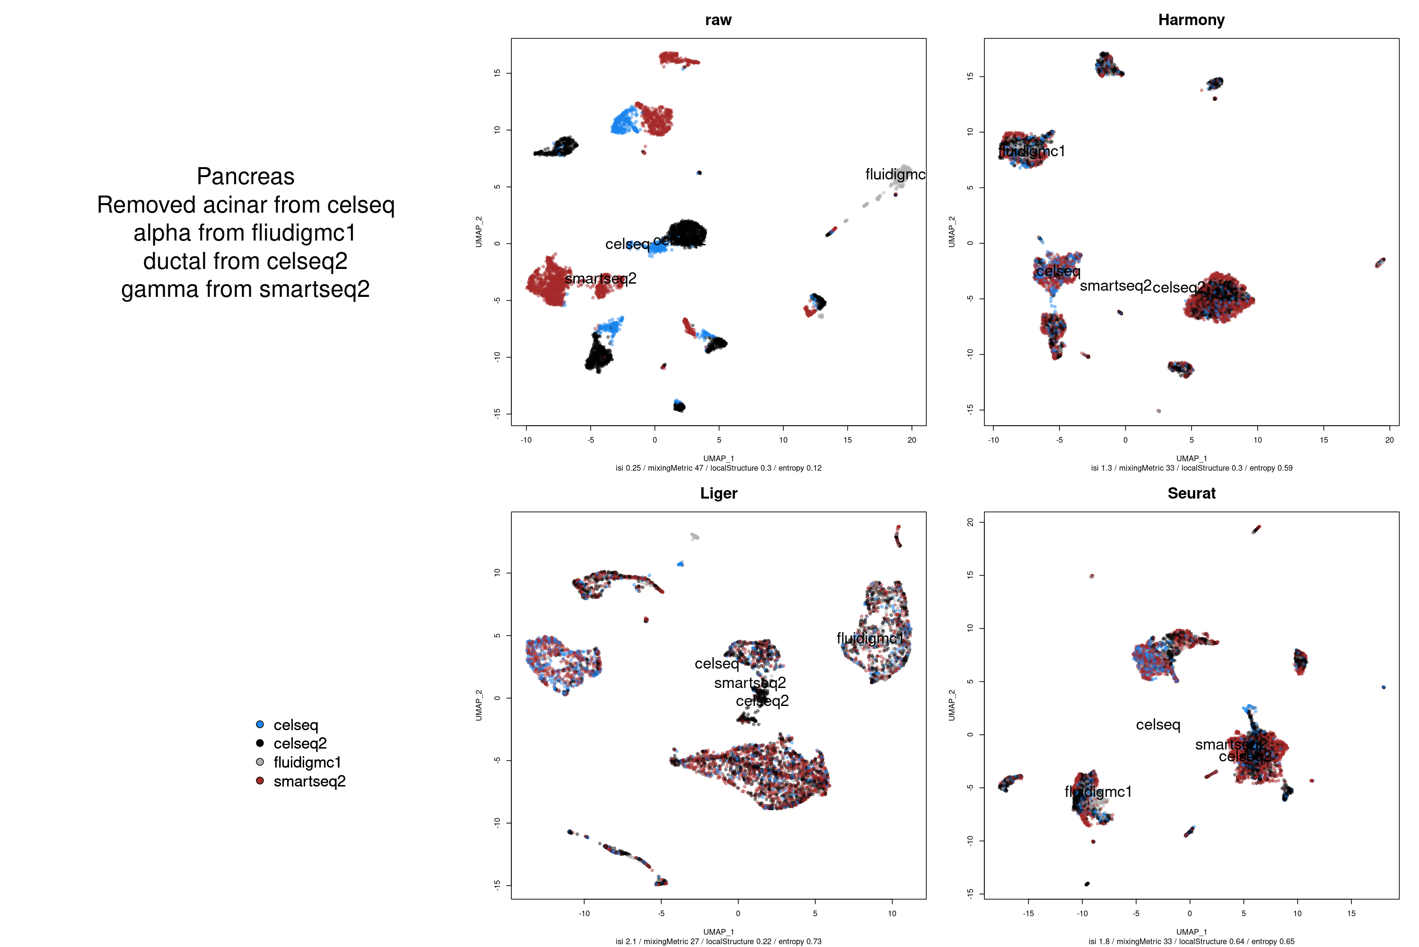
Human pancreas - removed cell types from specific datasets

Slide 20
Conclusions on negative controls
Seurat appears to overcorrect a spurious batch effect if requested to
Liger undercorrects when batches compositions are different
Harmony is less sensitive but does not overcorrect
Notes:
theta penalizes for clusters’ homogeneity

Slide 21
Questions adressed
Sensitivity: are the different algorithms able to correct for batch effects?
Specificity: Do they accurately retain biological variation? Do they preserve discrete cell identities? Continuums?
Do they scale well with increasing numbers of batches?

Slide 22

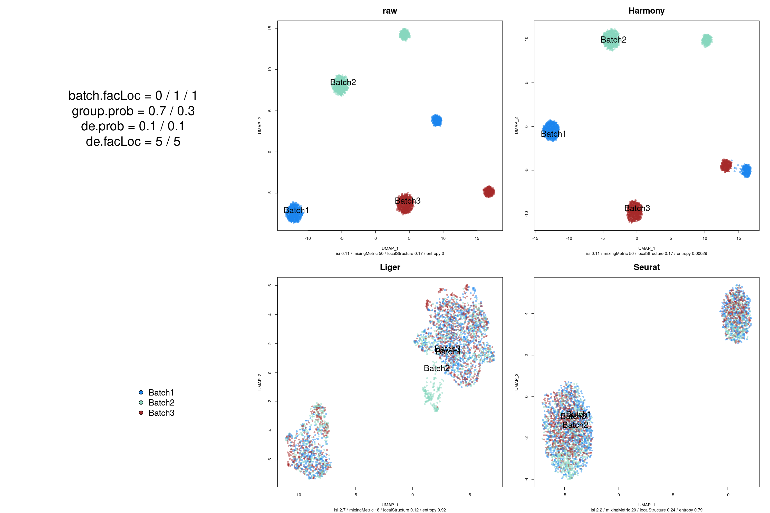
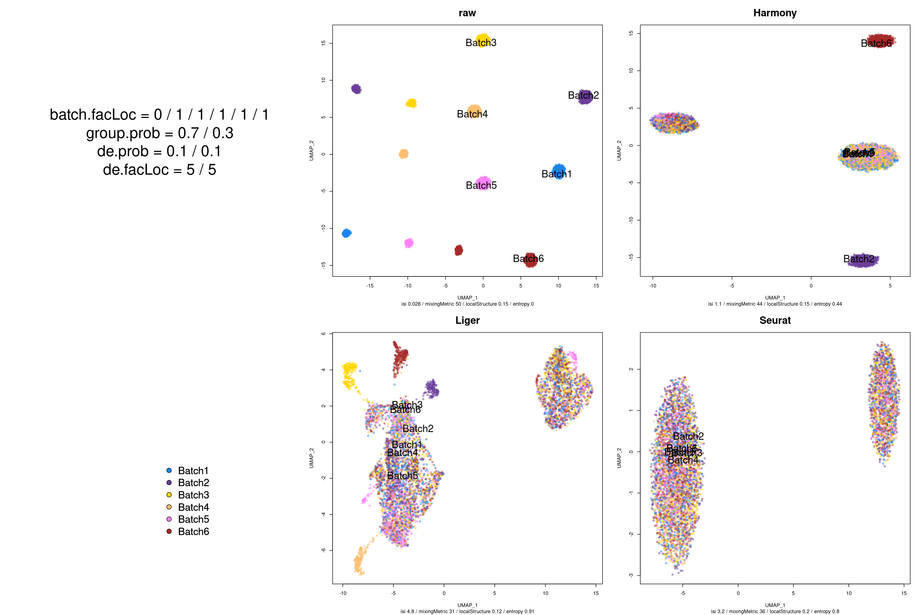
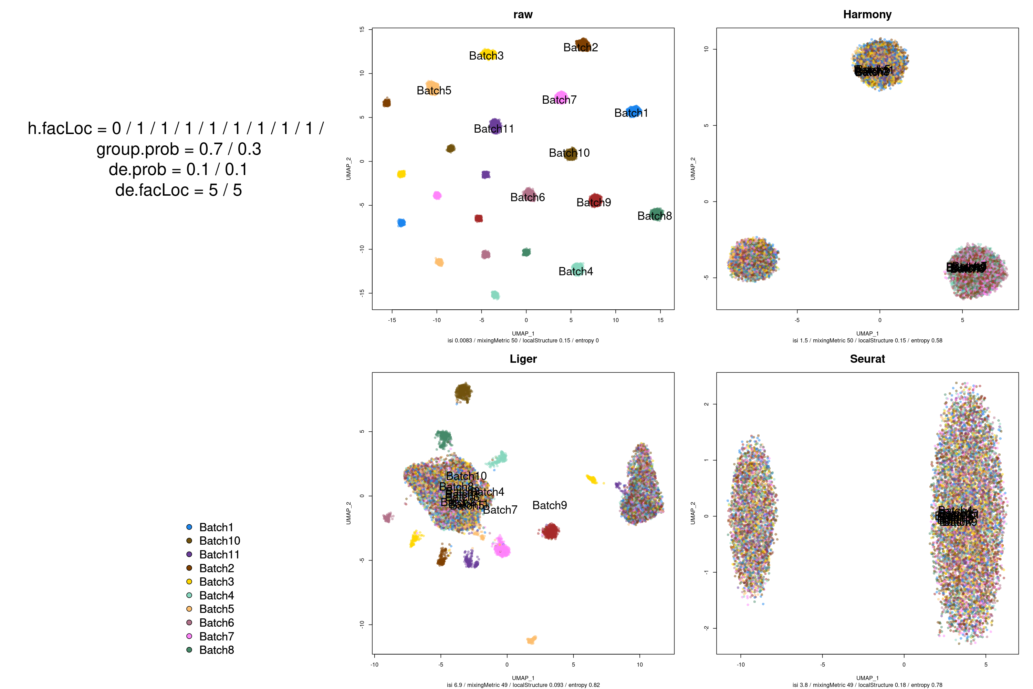
Number of batches
2
3
6
11
Raw
2 cell types
Varying number of batches
Truth
Harmony
UMAP2
UMAP1
Liger
Seurat

Slide 23
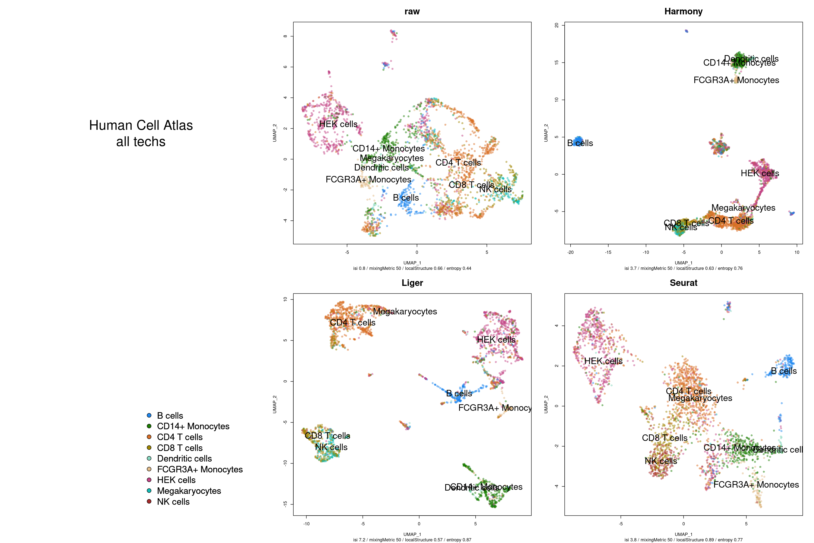
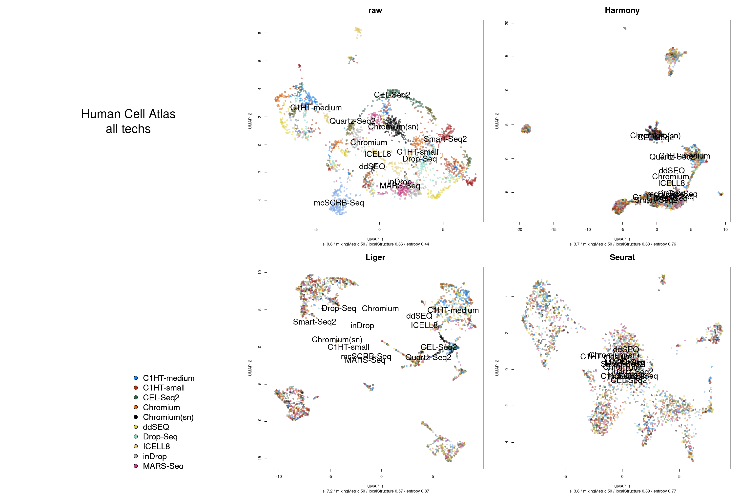
Human cell atlas: PBMCs, many scRNAseq protocols
Notes:
“many batches” case
Harmony missing some cell types
Seurat maybe overclustering

Slide 24
Conclusions on the number of batches
Seurat scales well with number of batches (it naively extends the strategy used for n=2)
Harmony and Liger undercorrect batch effects when too many batches present. Increase number of optimization rounds?
Notes:
theta penalizes for clusters’ homogeneity

Slide 25
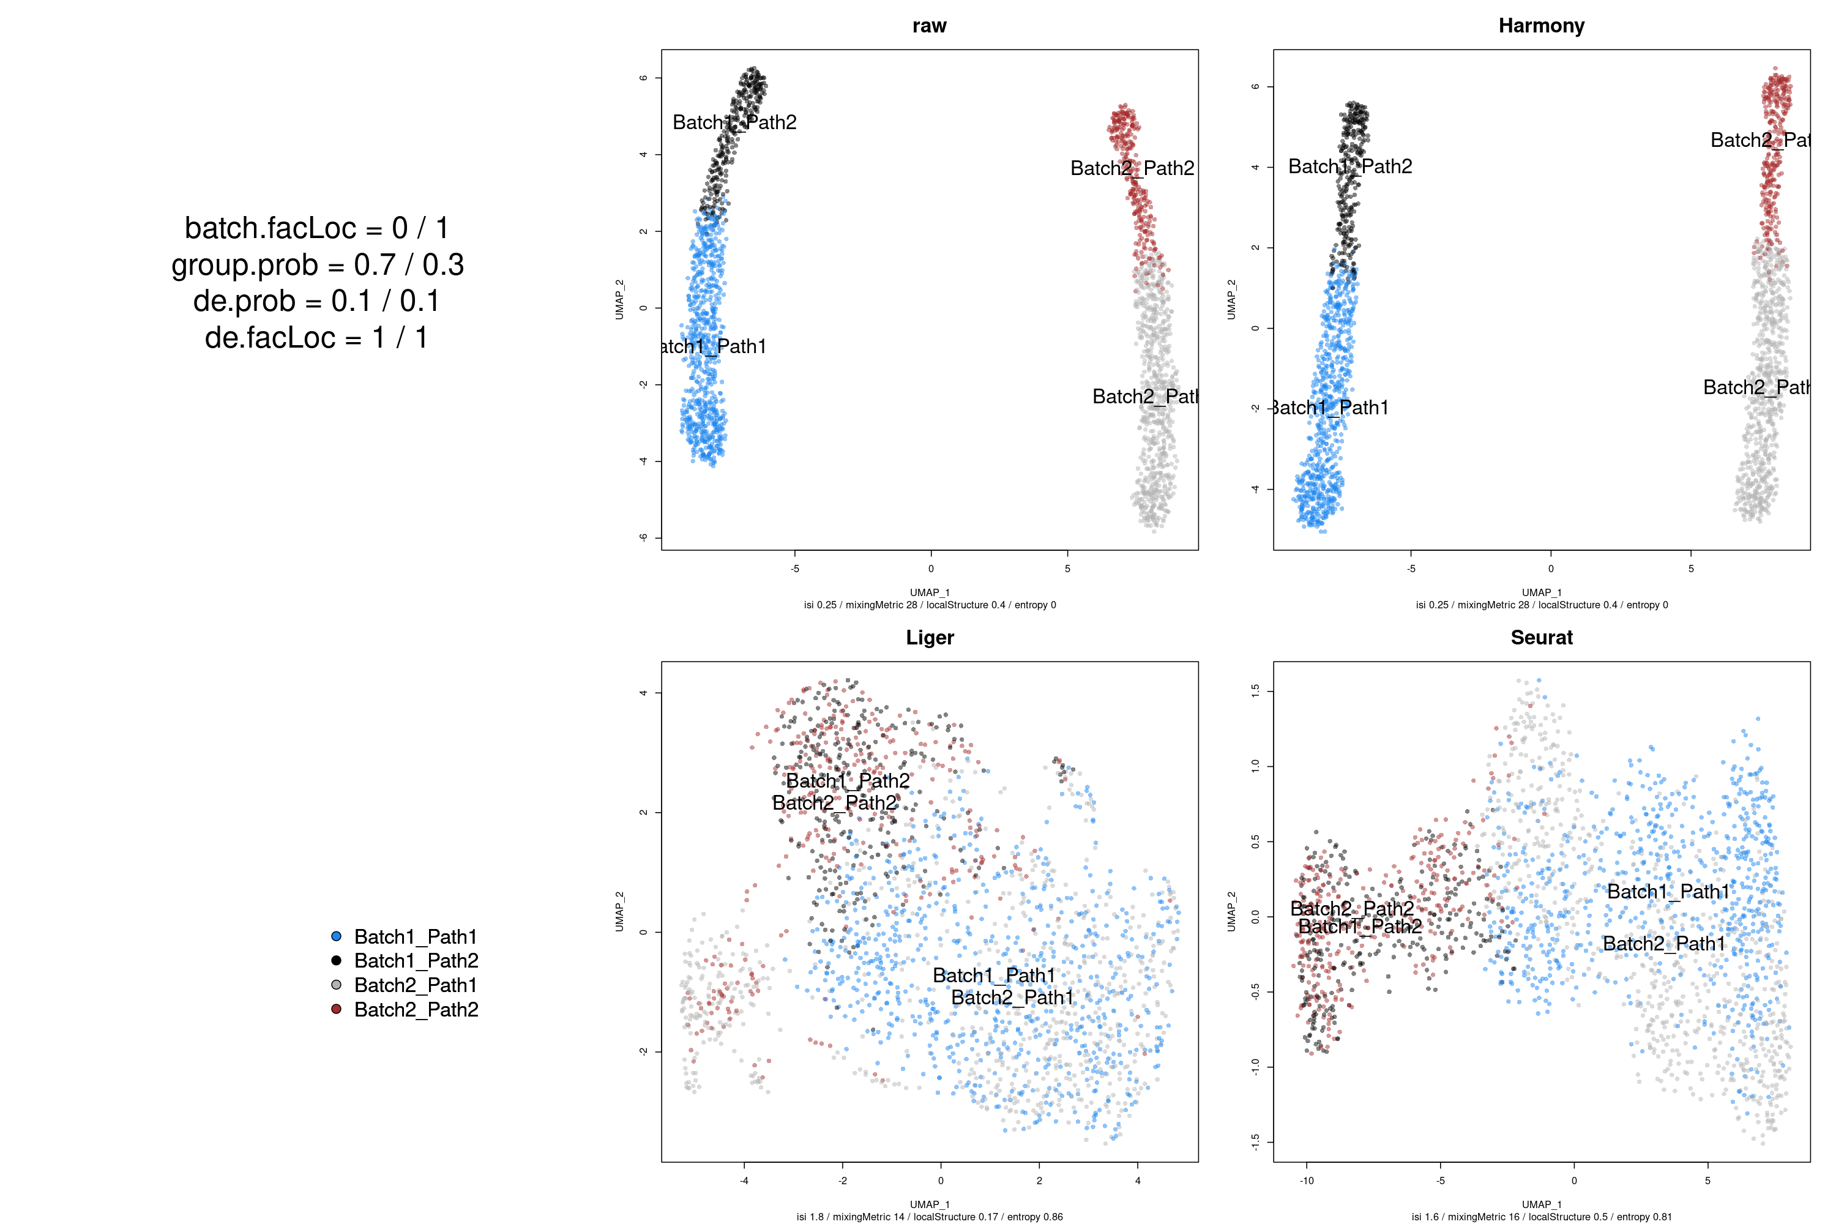
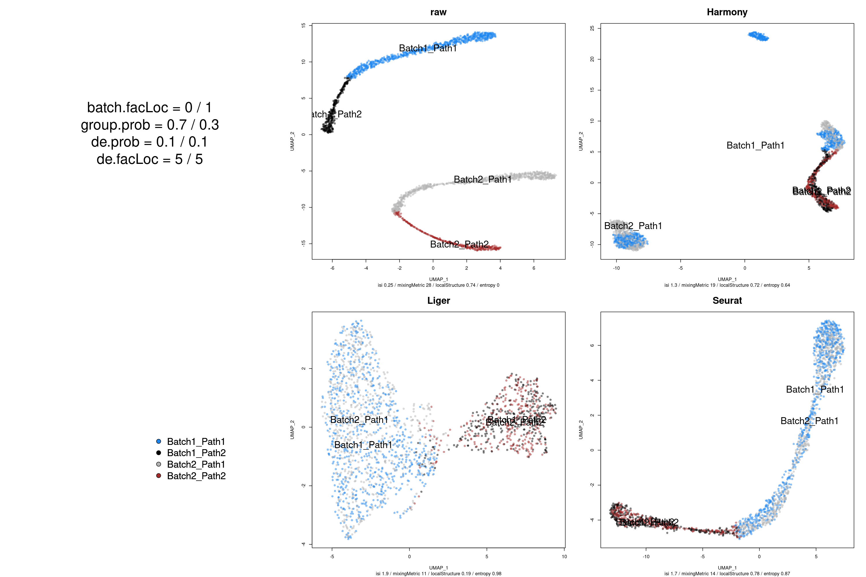
Trajectories
Effect sizes:
1
5
Raw
2 batches,
2 continuous cell types with a common origin
Truth
Harmony
UMAP2
UMAP1
Liger
Seurat

Slide 26
Conclusions on trajectories
Seurat appears to be sensitive and accurately retains continuous relationships
Liger corrects for the batch effect but obfuscates the trajectory
Harmony is less sensitive and may break the trajectories
Notes:
theta penalizes for clusters’ homogeneity

Slide 27
Conclusions
Seurat v3 is the most sensitive but also tends to overcorrect
Harmony misses small biological heterogeneity in the presence of a strong batch effect, but that does not seem to be a problem with real datasets. Can be mitigated with parameters if necessary
Liger sometimes undercorrects or merges rare cell types
 | Strong batch effect | Distinct batch compositions | Trajectories
Harmony | X | ✓ | X
Liger | X | ✓ | ~
Seurat | ✓ | X | ✓

Slide 28
Questions?

